Slide 1

CEACAM6 as a Biomarker for
Cholangiocarcinoma
Flavio G. Rocha, M.D.
Staff Surgeon, HPB Surgery
Co-Director of Research, Digestive Disease Institute
Virginia Mason Medical Center
Seattle, WA

Slide 2
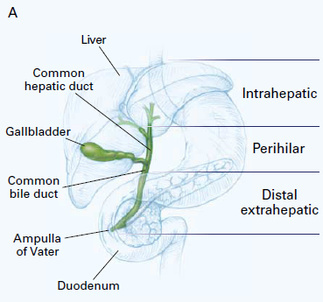
Not all Biliary Tract Cancers are the Same
Molecular and clinical behavior different between biliary tract cancers (GBCA, CCA and distal bile duct/periampullary)
Within CCA, hilar tumors and intrahepatic tumors have different biology
Clinical trials often group these populations of patients in order to achieve enough numbers for statistical considerations
deGroen, NEJM 1999

Slide 3
Diagnostic Dilemma
Clinical presentation of abdominal pain, jaundice, weight loss, anorexia and malaise is non-specific.
Laboratory investigations reveal increase in liver function tests and can arise in benign disease
Radiographic findings are suggestive but not confirmatory
Endoscopic brushings positive 40-70%
Biomarkers for early diagnosis are lacking

Slide 4
Established Tumor Markers
Serum CA 19-9 most widely used circulating marker for cholangiocarcinoma and pancreatic cancer
Consists of antibody raised against CRC reacts with high MW mucin glycoproteins coated with sialyl Lewis epitopes
Not present in 7% of the population
Accuracy reduced in the presence of cholangitis or cholestasis
Levels increased in smokers
Bonney et al, Lancet Onc 2008;9:149-58

Slide 5
Biomarkers in Serum versus Bile
Serum is readily accessible but contains a wide range of proteins and abundance of albumin and immunoglobulins
Bile is more proximal fluid source enriched by secreted or shed markers directly from tumors but requires invasive procedures for collection (surgery or endoscopy)
Purification and pre-analysis factors

Slide 6
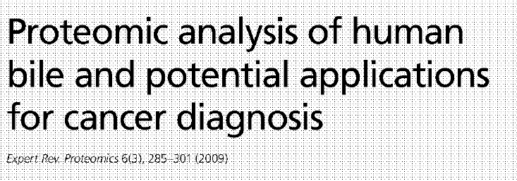

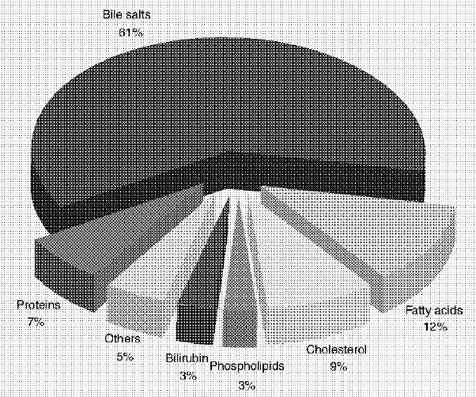
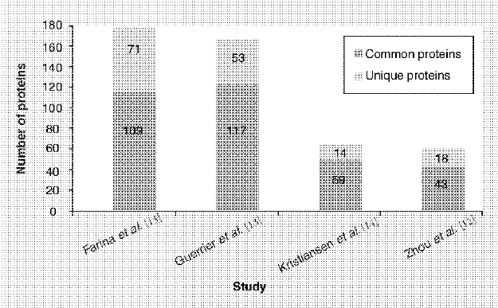

Slide 7

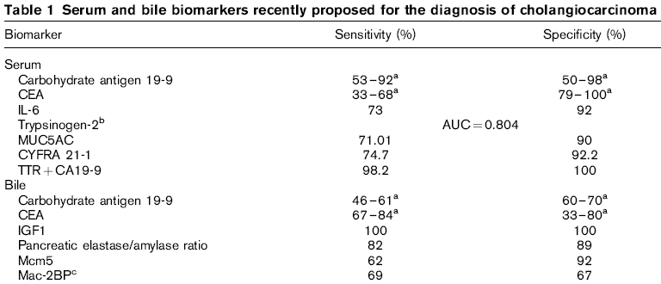

Slide 8
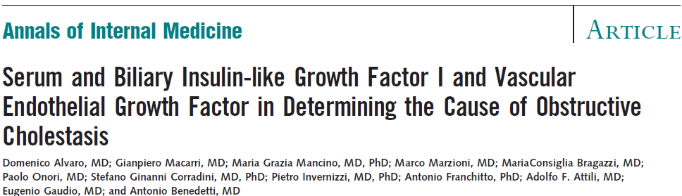
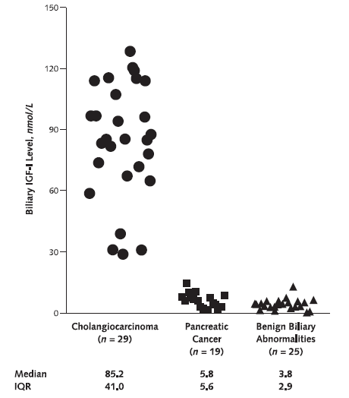
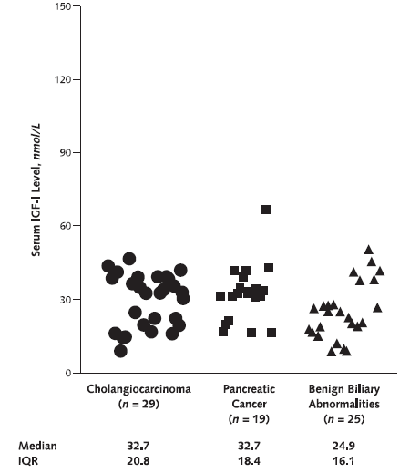

Slide 9
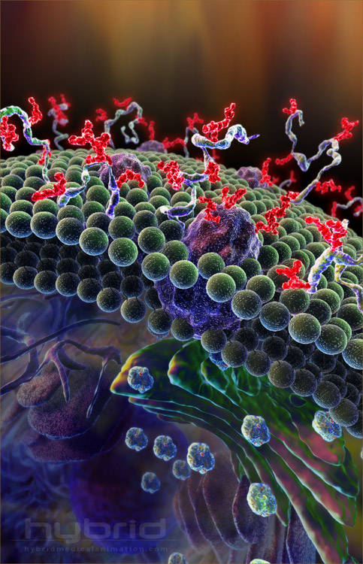
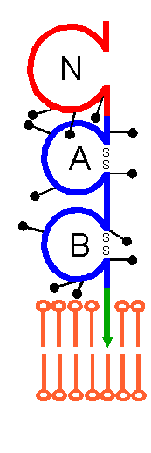
Carcinoembryonic Antigen 6 (CEACAM6)
GPI-anchored member of CEA family
Functions in cell adhesion and signal transduction pathways
Upregulates cellular invasion, anoikis and chemoresistance
Overexpressed in various epithelial malignancies (GI, lung, breast)
Associated with poor prognosis in colorectal cancer, intrahepatic cholangiocarcinoma and pancreatic adenocarcinoma
Duxbury et al Ann Surg 241, 491-6 (2004) Janscheff et al J Clin Onc 21, 3638-46 (2003) Ieta et al Br J Cancer 95, 532-40 (2009)

Slide 10
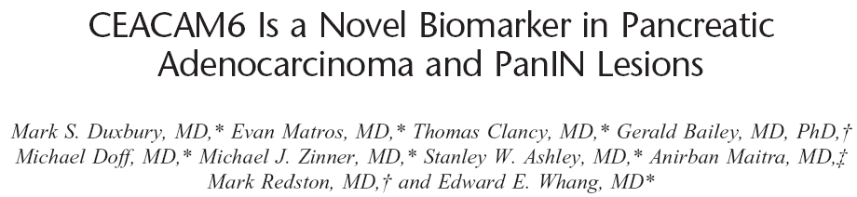
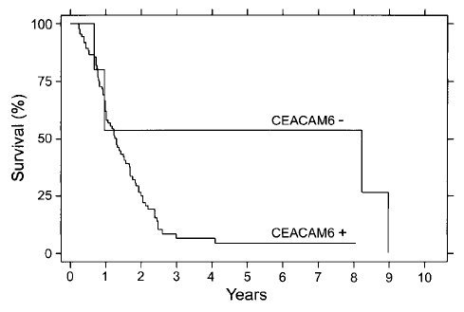

Slide 11
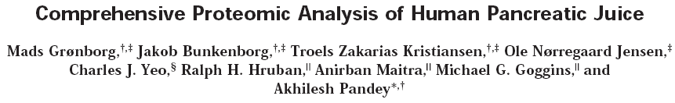
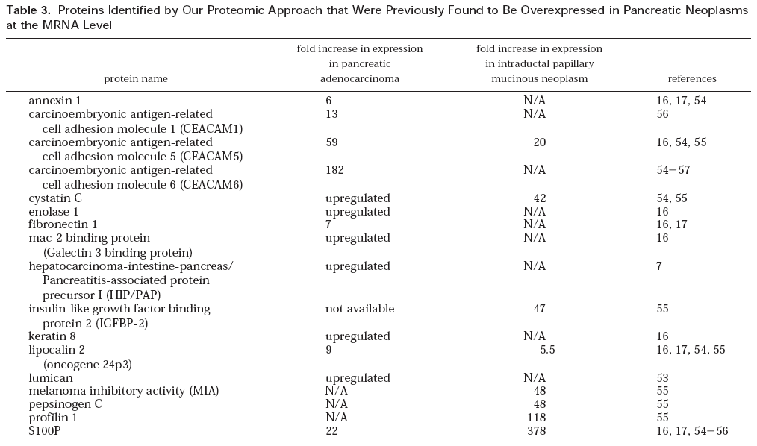

Slide 12
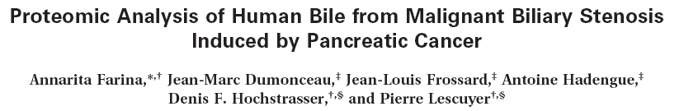
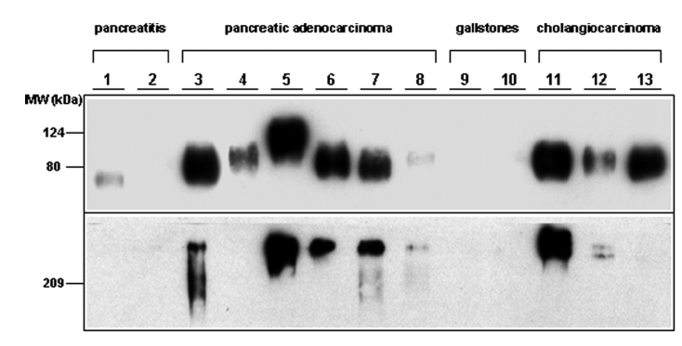
CEACAM6
CA19-9

Slide 13
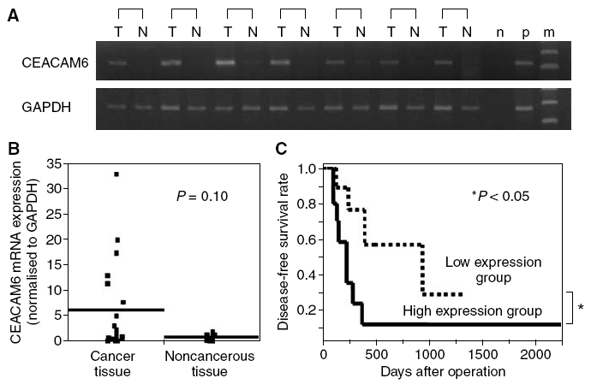

Slide 14
Pilot Study
MSKCC tissue microarrays constructed from original formalin-fixed, paraffin-embedded tumor specimens from patients with cholangiocarcinoma
Probed for CEACAM6 by immunohistochemistry
The association between tumoral CEACAM6 staining and clinicopathological variables was examined

Slide 15
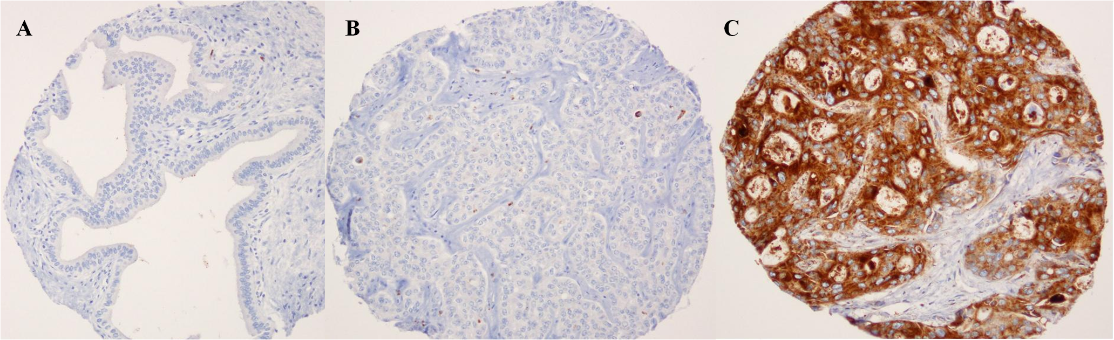
representative Immunohistochemistry
Panel A: Normal BILe DUCT Panel B: CEACAM6 (-) Tumor Panel C: CEACAM6 (+) Tumor

Slide 16
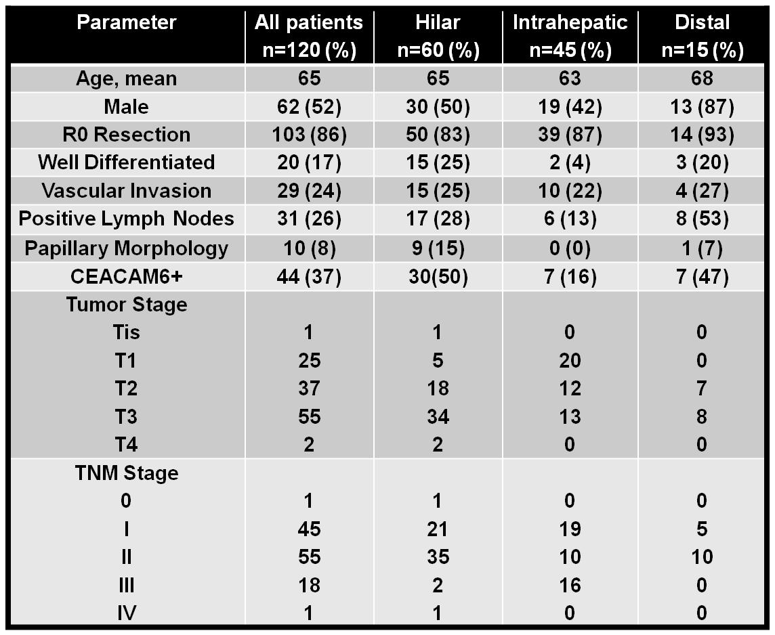
Tissue microarray by ceacam6

Slide 17
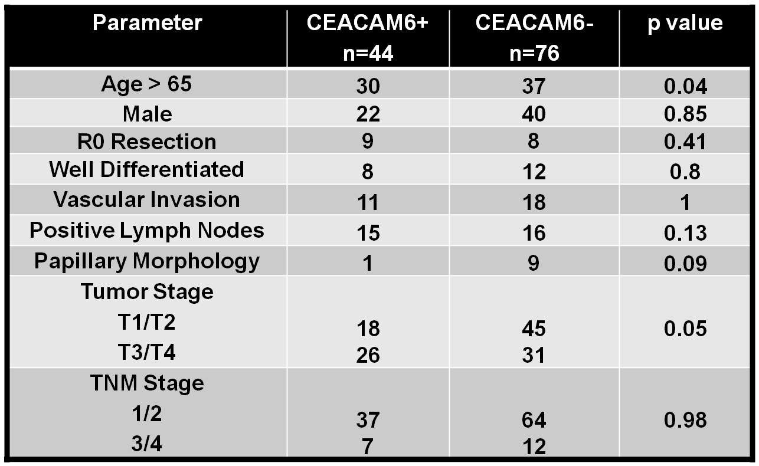
Clinicopathologic parameters

Slide 18
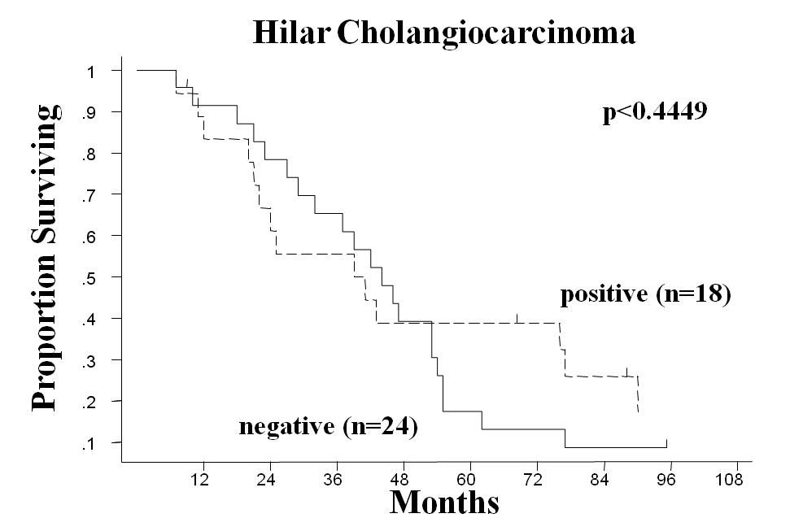
DISEASE-SPECIFIC SURVIVAL following
R0 resection BY ceacam6 eXPRESSIOn
Hilar Cholangiocarcinoma
1
1
.9
p<0.4449
.9
.8
.8
.7
.7
.6
.6
Proportion Surviving
.5
.5
positive (n=18)
.4
.4
.3
.3
.2
.2
negative (n=24)
.1
.1
12
24
36
48
60
72
84
96
108
Months

Slide 19
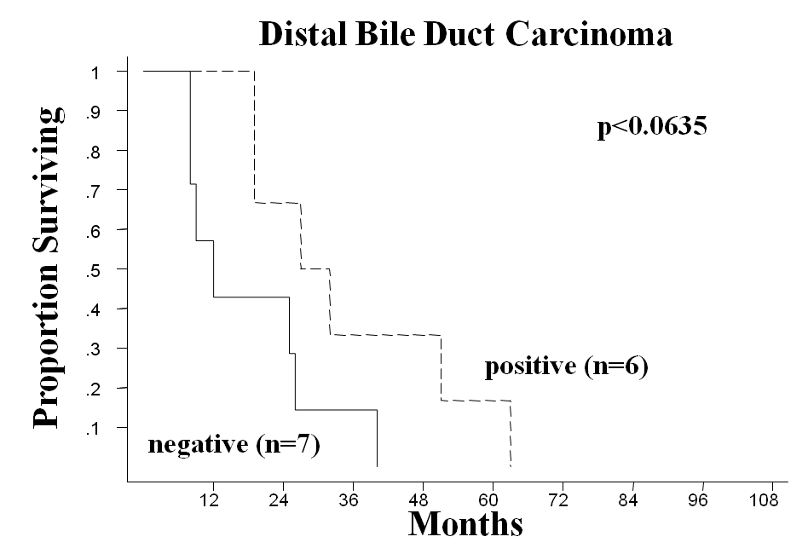
DISEASE-SPECIFIC SURVIVAL following
R0 resection BY ceacam6 eXPRESSIOn

Slide 20
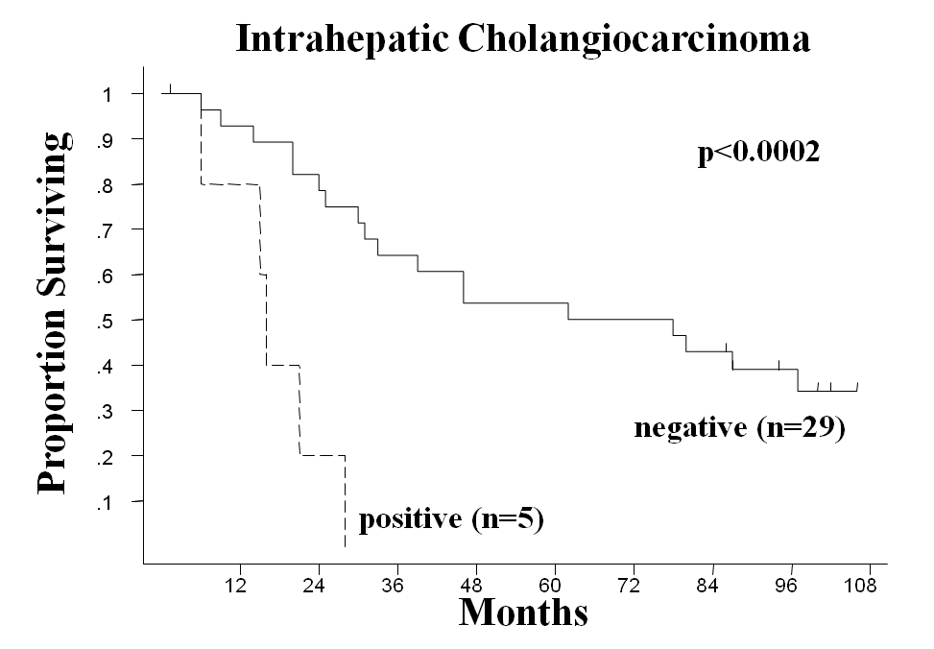
DISEASE-SPECIFIC SURVIVAL following R0 resection BY ceacam6 eXPRESSIOn

Slide 21
Phase II Study of Hepatic Artery Infusion (HAI) with Floxuridine (FUDR) and Dexamethasone (Dex) Combined with Systemic Gemcitabine and Oxaliplatin in Patients with Unresectable Intrahepatic Cholangiocarcinoma (ICC)
PI: William Jarnagin, MD PI MSKCC NCT01862315
Correlative Study:
Liver biopsy at the time of pump placement from tumor and adjacent normal tissue
CEACAM6 expression will be semi-quantified by IHC and correlated to therapeutic response and PFS

Slide 22
Protocol
All MSKCC patients undergoing resection or biliary bypass for cholangiocarcinoma, gallbladder cancer, pancreatic cancer, and pancreatic cystic neoplasms
Patients undergoing ERCP for benign disease will serve as controls
Up to 5cc of bile collected at the time of bile duct transection or ERCP
Snap frozen in liquid nitrogen and stored at -80º C for later analysis
CEACAM6 levels quantified using ELISA and WB
Patient clinicopathological parameters and outcome correlated with levels of CEACAM6 expression

Slide 24
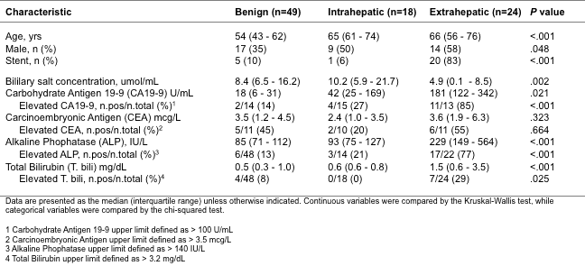
Patient characteristics

Slide 25
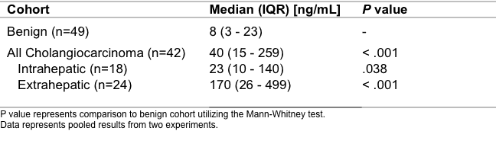
CEACAM6 Levels by ELISA

Slide 26
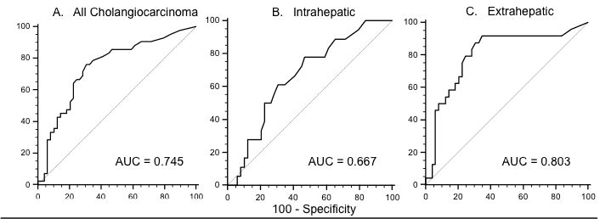
Receiver Operator Curve

Slide 27
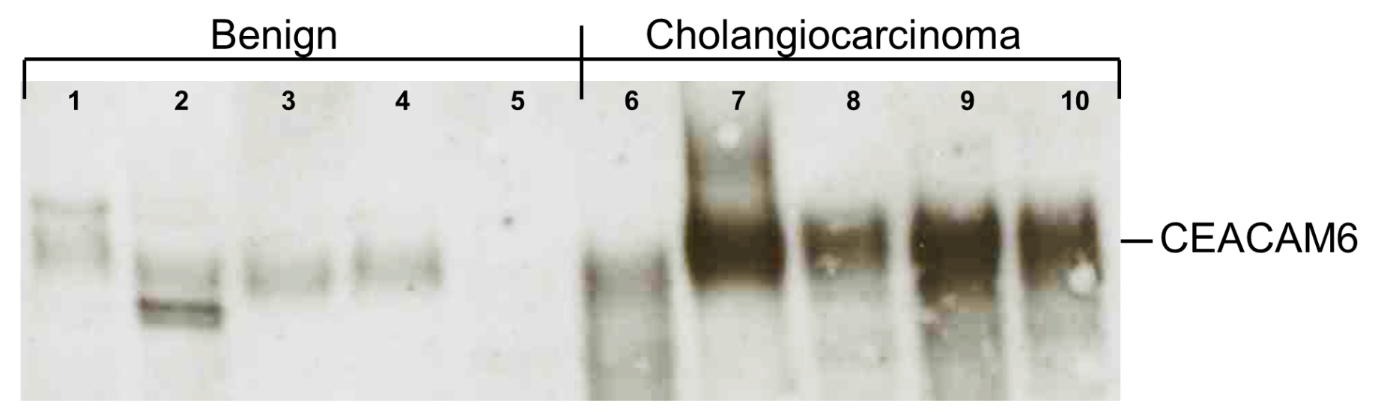
Representative Western Blot

Slide 28
Summary
CEACAM6 is a prognostic marker in intrahepatic cholangiocarcinoma
CEACAM6 levels in bile can be used to distinguish cholangiocarcinoma in extrahepatic but not intrahepatic bile ducts from benign biliary disease
To be determined if CEACAM6 is a predictive biomarker through clinical trials and translational research

Slide 29
miRNA Profile of Cholangiocarcinoma
Future Directions

Slide 30
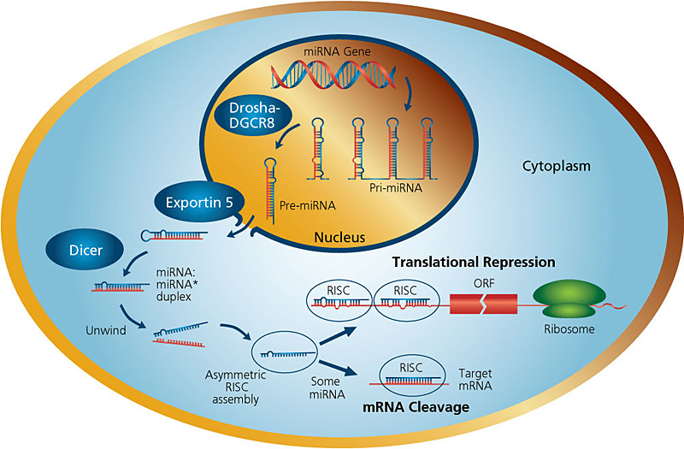
miRNA

Slide 31
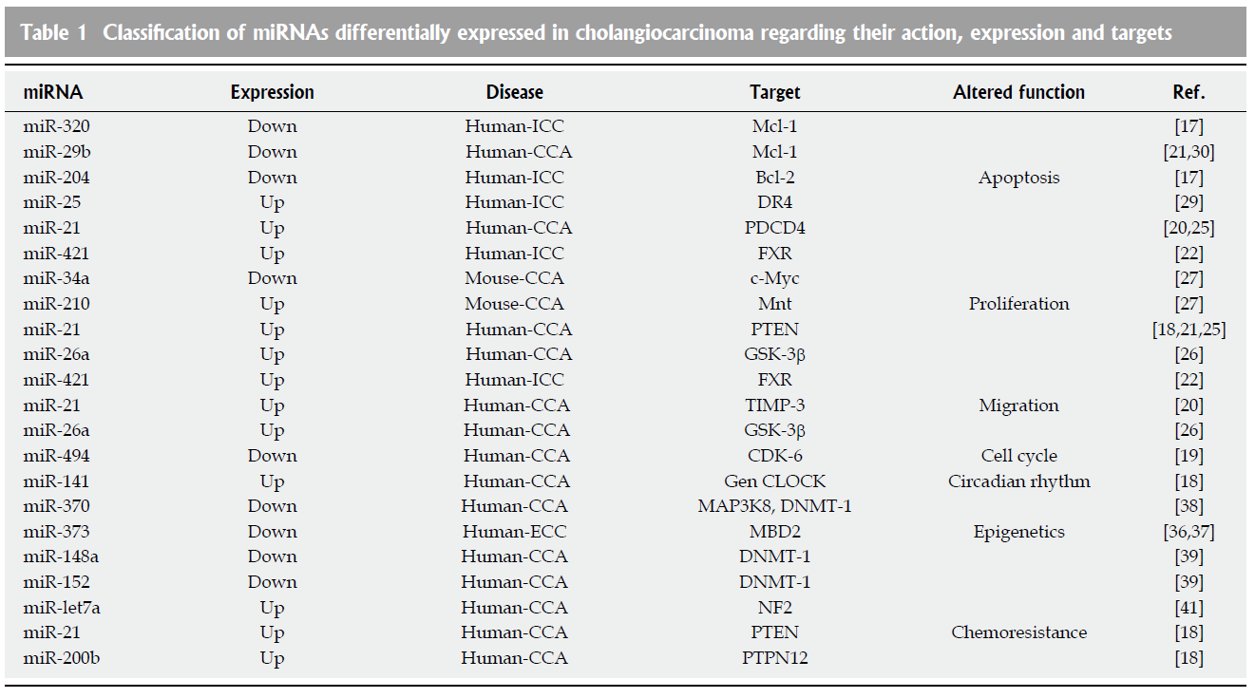
miRNAs in CCA

Slide 32
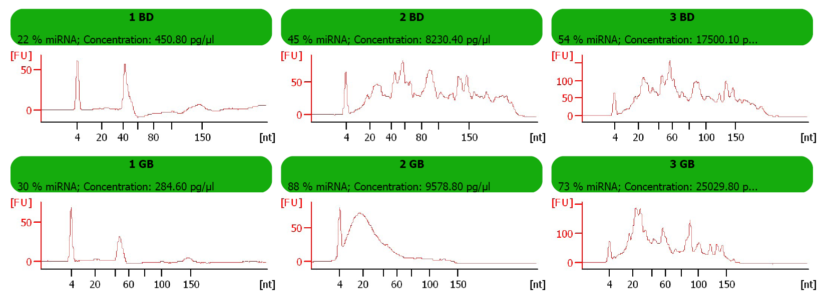
Small RNAs are increasingly degraded in bile stored in gallbladder
Increased small RNA degradation is attributed to bile duct obstruction
Liver
3
Bile collected from bile duct absent of obstruction is more suitable for miRNA biomarker identification
2
1

Slide 33
RNA yield from bile is high enough for miRNA profiling by real-time PCR
ng/150uL bile

Slide 34
Hypothesis
The development of cholangiocarcinoma is preceded by a change in miRNA expression, that can be utilized as a biomarker for disease progression in high risk populations

Slide 35
Design
Fisher 344 rats +/- thioacetamide x 22wks
Terminal surgery at 0, 4, 10, 16, and 22wks
Collect tissue, bile, and serum
RNA sequencing in triplicate:
  0wk (-)Thio liver
  22wk (-)Thio liver
  22wk (+)Thio tumor
  22wk (+)Thio adjacent normal liver
Confirm profile in previous serum/bile samples by RT-PCR

Slide 36
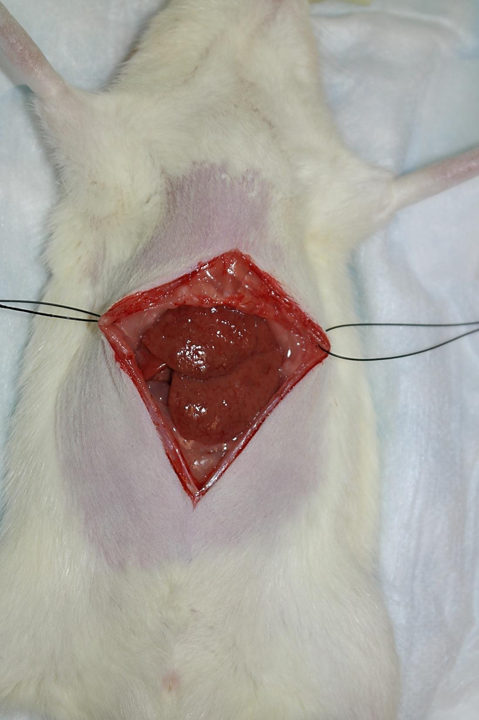
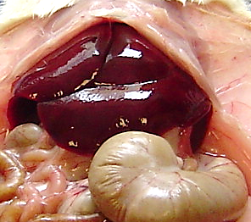
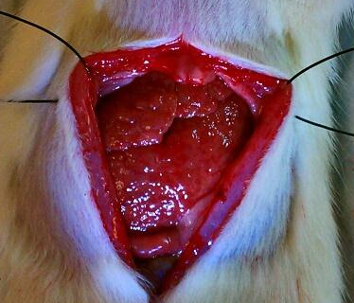

Slide 37
Rat Intrahepatic CCA
Thioacetamide Control

Slide 38
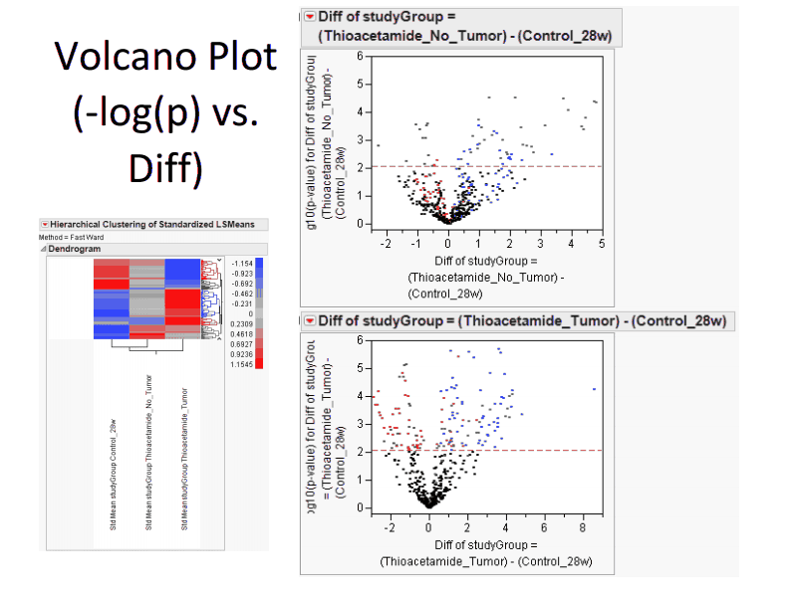
miRNA Volcano Plot

Slide 39
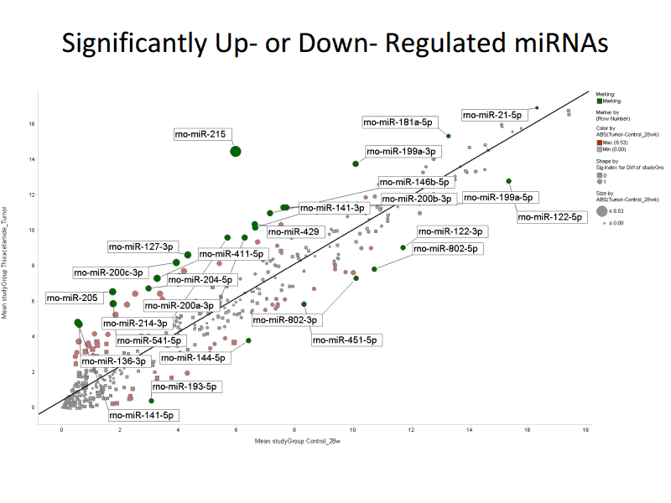
Tumoral miRNA Expression

Slide 40
Acknowledgements
  Memorial Sloan-Kettering
HPB Service
  William R. Jarnagin, MD
Pathology
  Nora Katabi, MD
  David S. Klimstra, MD
Biostatistics
  Mithat Gonen, PhD
  Joanne Chou, PhD
VM/Benaroya Research Institute
Surgery
  J Bart Rose, MD
Hepatology
  Kris Kowdley, MD
  James Nelson, PhD
  Yu Li, PhD
Pathology
  Hejin Hahn, MD
Supported by a Young Investigator Award from Conquer Cancer Foundation of ASCO, thr Cholangiocarcinoma Foundation, and Kenneth Wilske Translational Research Pioneer Award

