Slide 1


Implementation of Precision Medicine Approaches in Intrahepatic Cholangiocarcinoma
Daniela Sia, PhD
Icahn School of Medicine at Mount Sinai
Mount Sinai Liver Cancer Program
Divisions of Liver Diseases
New York, NY
CCF Grantee Webinar Series I
10-26-15
daniela.sia@mssm.edu

Slide 2
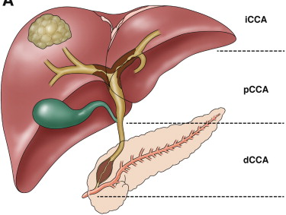
Intrahepatic Cholangiocarcinoma
Background
Intrahepatic Cholangiocarcinoma (iCCA) is the second most common liver cancer, accounting for less than 5% of all gastrointestinal tumors (Rizvi and Gores, Gastroenterology 2013).
iCCA arises from the small bile ducts within the liver and forms classic mass lesions in 85% of cases (Gores, Gastroenterology 2005).
Rizvi and Gores, Gastroenterology 2013
Typically, iCCA has poor prognosis, being resection the main treatment option in 30-40% of cases (ILCA guidelines, J Hepatol 2014).
At more advanced stages, chemotherapy regimens are considered standard of practice (i.e. cisplatin plus gemcitabine) (Valle et al. NEJM 2010).

Slide 3
Intrahepatic Cholangiocarcinoma
Treatment Algorithm
Diagnosis of iCCA
TNM Stage I
TNM Stage II
TNM Stage III
TNM Stage IV
Single tumor
Single or multinodular, vascular invasion (Vi)
Visceral peritoneum perforation, local hepatic invasion
Periductal invasion, N1, M1
Resectable (30-40%)
Unresectable (60-70%)
Intrahepatic Disease Only
Extrahepatic Disease
Curative
Resection
Noncurative
Resection
Consider Local-regional therapy
Gemcitabine
& Cisplatin
*
*
Observation
Enroll in studies of adjuvant Therapy
5-yr survival R0: 40%
5-yr survival N1 or VI: 20%
RF/TACE: median survival 15 mo
Chemotherapy: median survival 12 mo
*
Recommended as standard of practice.
ILCA Guidelines, J Hepatol 2014

Slide 4
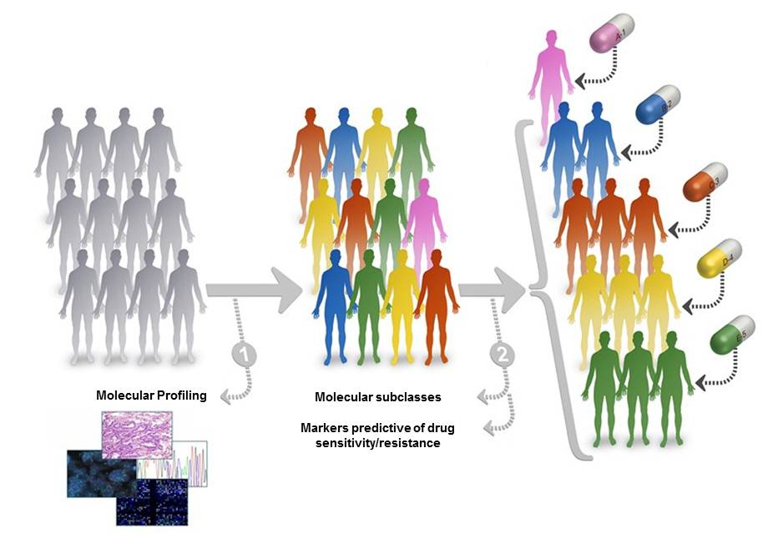
Intrahepatic Cholangiocarcinoma
Unmet needs
Increasing incidence and poor outcome
No standard of care for unresectable cases (60-70%)
Marginal understanding of molecular pathogenesis
Molecular therapies are not available
Clear need for integrative genomic analysis studies combining genetic alterations with pathway identification
Personalized medicine
Patient stratification
and
genetic biomarkers to direct therapy

Slide 5
Intrahepatic Cholangiocarcinoma
Molecular classification
Proliferation
n=92 (62%)
Inflammation
n=57 (38%)
iCCA MOLECULAR SUBCLASSES
P1
P2
P3
I1
I2
I3
MOLECULAR CHARACTERISTICS
Poor prognostic signatures
(i.e. G3, S1, S2, Cluster A,
CC-like, recurrence)
none
IGF1R, MET
Stem-like ICC
EGFR
Gene signatures enrichment
EGFR
Over-expression of IL3, IL4, IL6, IL10, IL17A, CCL19
Gene expression
Chrom. Stability
Chrom. Instability
Chrom. Stability
Chrom. Instability
Copy Number Variation
+1p, 7p
+ 7p
KRAS
EGFR
Mutation
Moderate/poorly differentiated
Intra-neural invasion
Well differentiated
CLINICAL CHARACTERISTICS
Poor survival
High recurrence
Good survival
Low recurrence
n=57 (38%)
Sia et al, Gastroenterology 2013

Slide 6
Intrahepatic Cholangiocarcinoma
Unmet needs
Increasing incidence and poor outcome
No standard of care for unresectable cases (60-70%)
Marginal understanding of molecular pathogenesis
Molecular therapies are not available
Clear need for integrative genomic analysis studies combining genetic alterations with pathway identification
Personalized medicine
Patient stratification
and
genetic biomarkers to direct therapy

Slide 7
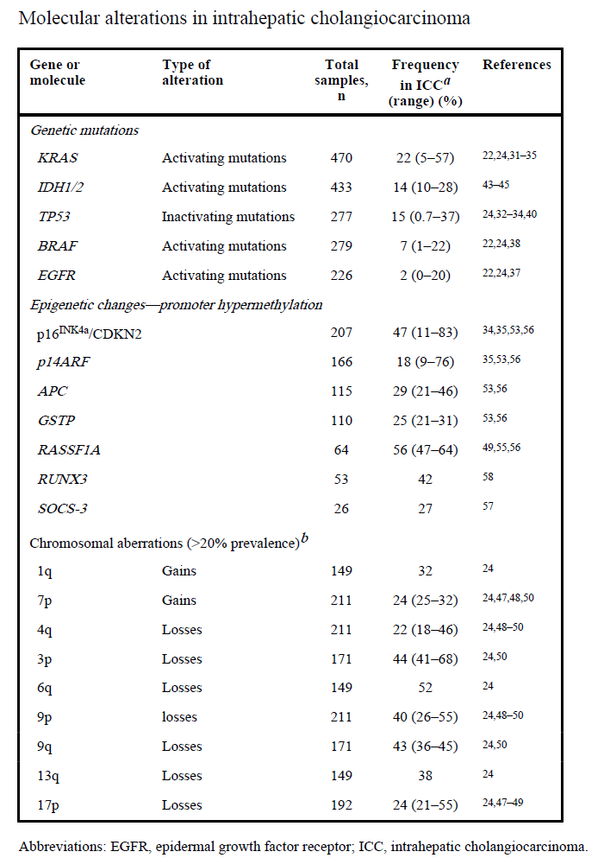
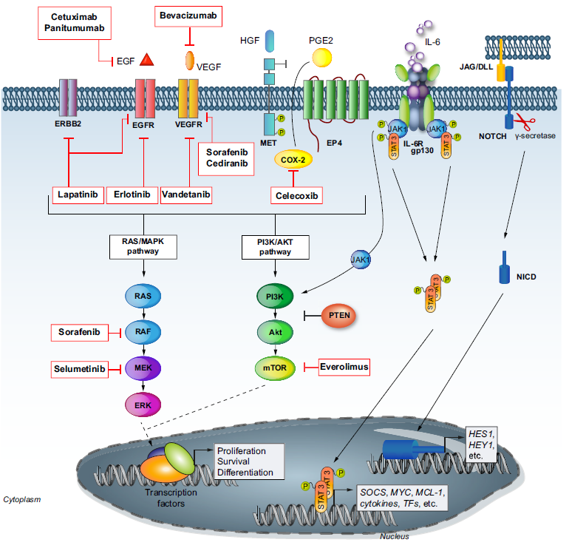
Intrahepatic Cholangiocarcinoma
Molecular alterations and targets for therapies
ILCA guidelines, J Hepatol 2014 adapted from Sia et al, Oncogene 2013

Slide 8
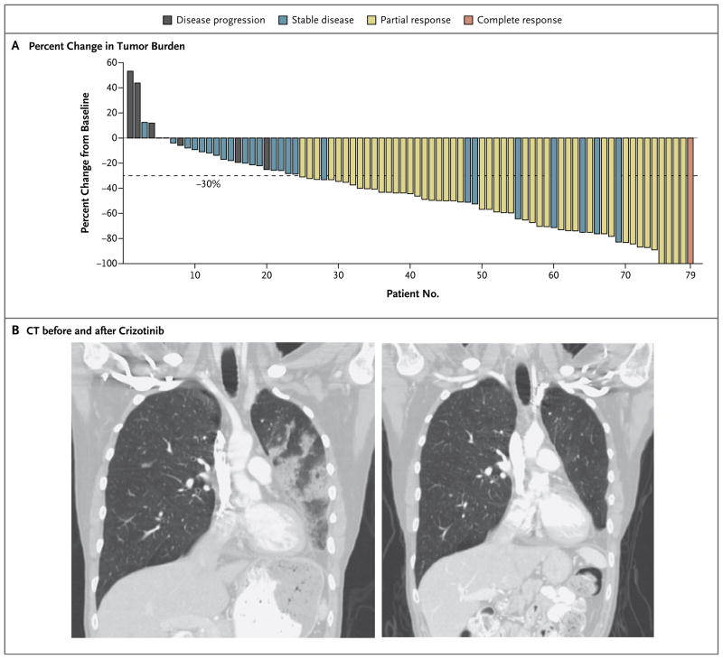
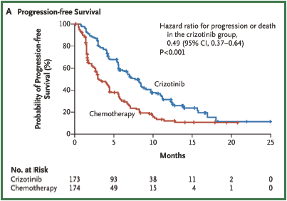
Discovery of novel therapeutic targets
Background
Fusion proteins are known to be potent driver oncogenes involved in the pathogenesis of human cancer and recent studies report dramatic therapeutic responses by blocking these targets (e.g. EML4-ALK/crizotinib in lung cancer).
Kwak et al, NEJM 2010
Shaw et al, NEJM 2013

Slide 9
Research Project
Discovery of novel therapeutic targets
The application of next-generation sequencing technologies would identify novel driver events that meaningfully contribute to iCCA pathogenesis and that might represent novel targets for more effective therapies.
Specific Aims
To identify novel molecular alterations by applying RNA-sequencing to fresh frozen iCCA tumors and their matched normal tissues.
To characterize the oncogenic potential of identified molecular alterations (fusion genes) and their incidence in a large cohort of human iCCAs.
To verify if such molecular fusion genes may represent novel targets for more specific therapies.

Slide 10
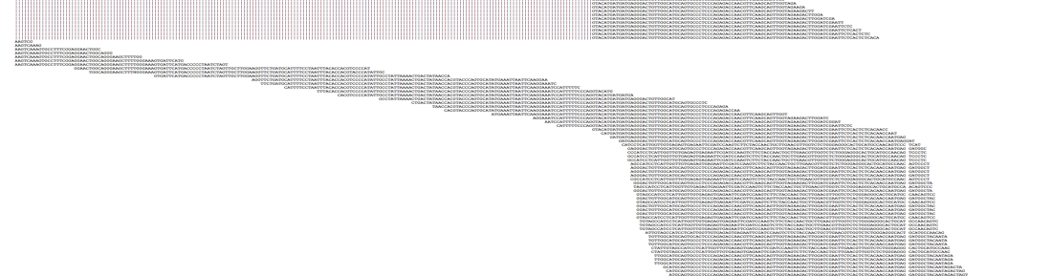
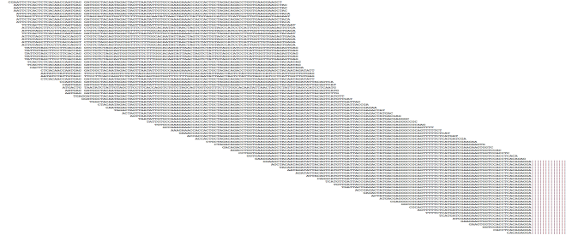

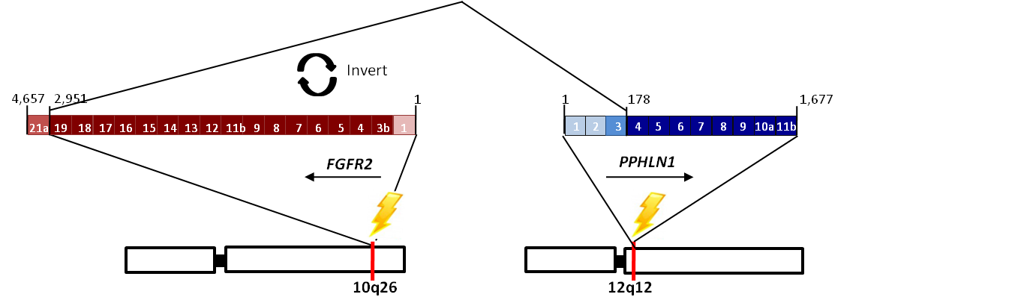
Identification of novel drivers by RNA-seq
RNA-seq data indentifies a novel FGFR2-PPHLN1 fusion gene
N=149 reads
FGFR2 - PPHLN1 mRNA
19
4
exons
1 2 3 4 5 6 7 8 9 10a 11b
Sia et al, Nat Commun 2015

Slide 11
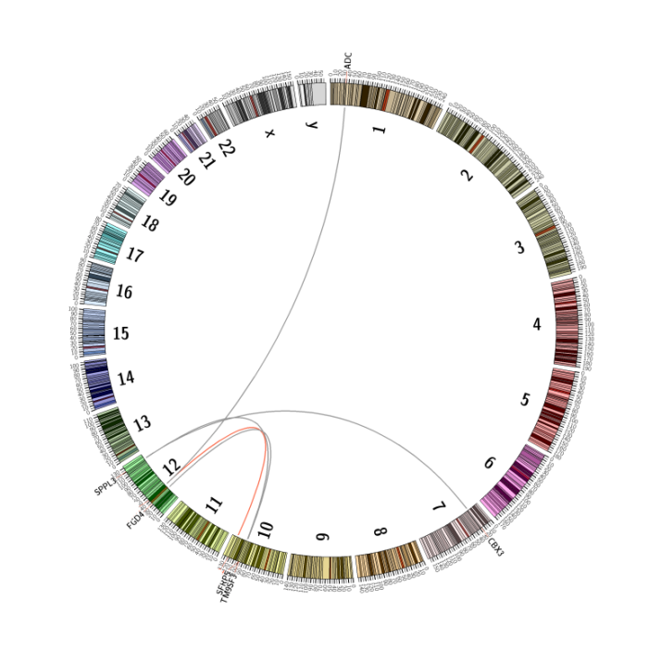
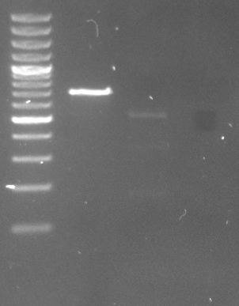
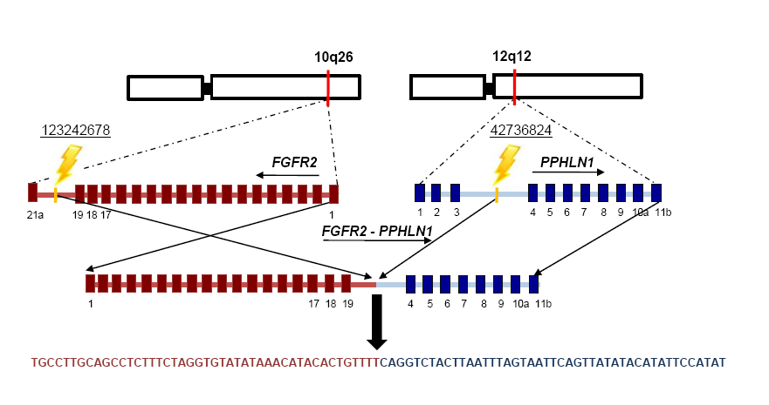
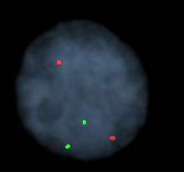
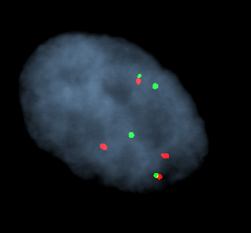
Identification of novel drivers by RNA-seq
DNA mechanism of FGFR2-PPHLN1 gene
A translocation t(10, 12) has been identified by whole genome sequencing
water
ICC23
ICC24
PPHLN1
FGFR2
Genomic PCR
FGFR2
FGFR2-PPHLN1
PPHLN1
Matched Normal Tissue – ICC23
Tumoral Tissue – ICC24
Sia et al, Nat Commun 2015

Slide 12
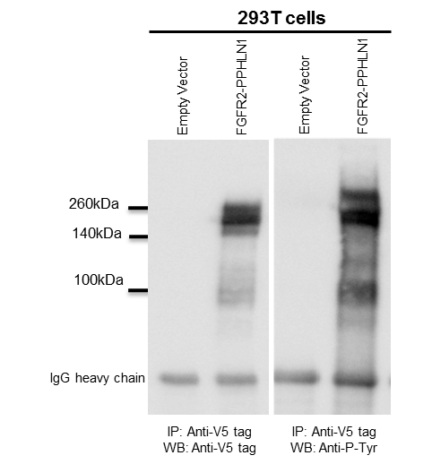
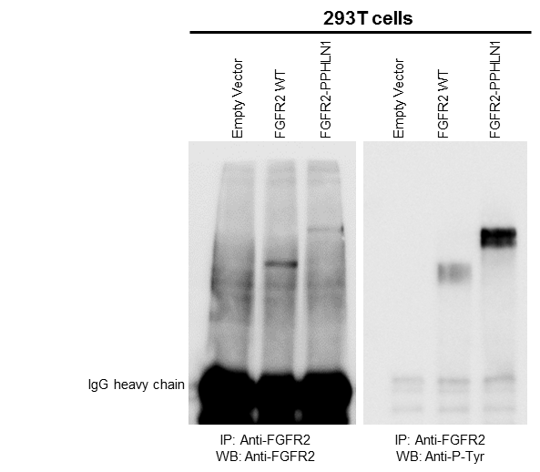

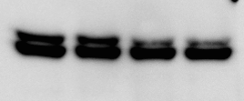

Identification of novel drivers by RNA-seq
FGFR fusion partner, PPHLN1, mediates activation of FGFR2
FGFR2
FGFR2 fusions
FGF
293T cells
IgG
Ligand-dependent activation
IgG
IgG
Plasma membrane
TK
P
P
P
P
P
TK
P
Constitutive activation
P
TK
P
P
P
P
TK
P
SOS
FRS2
RAF
RAS
GRB2
MEK
PI3K
STAT
Phospho-ERK
ERK
AKT
Total ERK
Tubulin
Proliferation, Survival, Angiogenesis
Gene expression
Sia et al, Nat Commun 2015

Slide 13
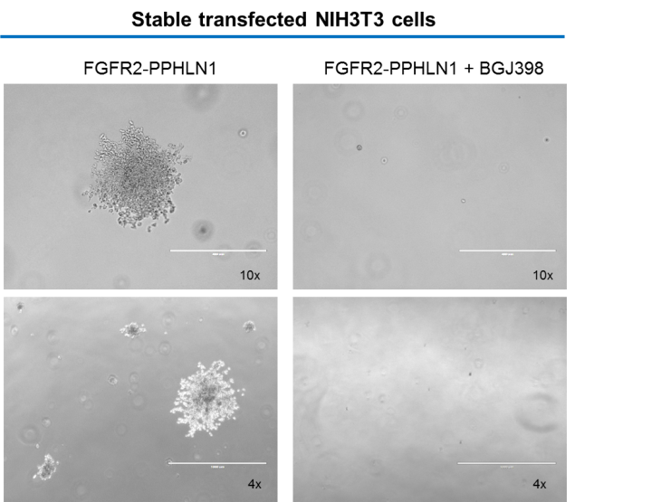
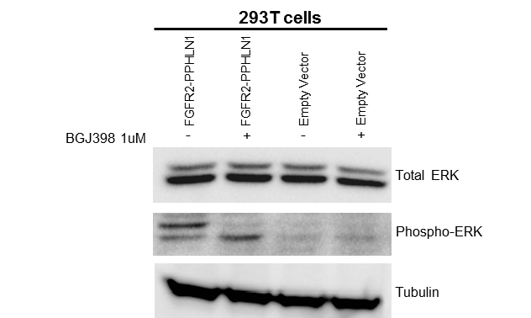
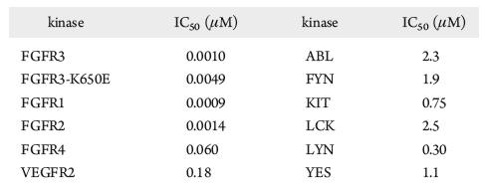
Identification of novel drivers by RNA-seq
Transforming potential of FGFR2-PPHLN1 fusion gene
Colonies Count
(Mean per well)
Efficacy of the selective FGFR2 inhibitor BGJ398 (FGFR1-3)
BGJ398: pan-FGFR inhibitor kinome profile

Slide 14
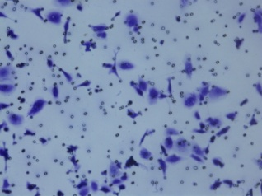
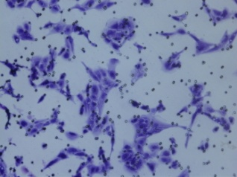
Identification of novel drivers by RNA-seq
Oncogenic potential of FGFR2-PPHLN1 in an iCCA in vitro model
P<0.001
P<0.001
P<0.001
Viability%
(referred to empty vector)
P<0.001
~50%
P=0.002
~60%
Sia et al, Nat Commun 2015

Slide 15
Identification of novel drivers by RNA-seq
FGFR2-PPHLN1 is a candidate therapeutic target in iCCA
Migration assay
MTS Assay - 72h Treatment
P<0.001
P<0.001
P<0.001
Viability %
(referred to DMSO)
Migrated cells/field
BGJ398
HUCCT1 Empty vector
HUCCT1 FGFR2-PPHLN1
Sia et al, Nat Commun 2015

Slide 16
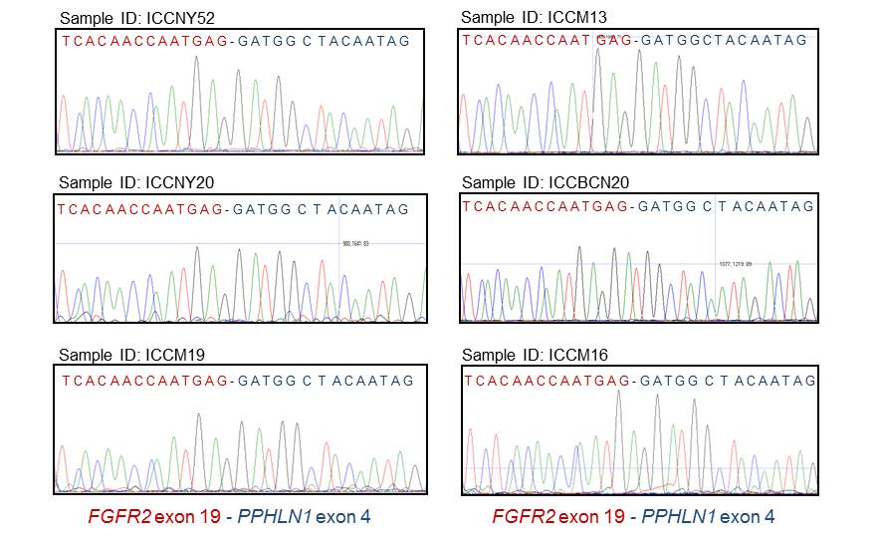
Identification of novel drivers by RNA-seq
Incidence of the FGFR2-PPHLN1 fusion gene
Screening of a large cohort of human iCCAs (n=107)
16% (n=17)
Representative Image of NEGATIVE Patient
Representative Image of POSITIVE Patient
FGFR2
PPHLN1
FGFR2
FGFR2-PPHLN1
FGFR2-PPHLN1
PPHLN1

Slide 17
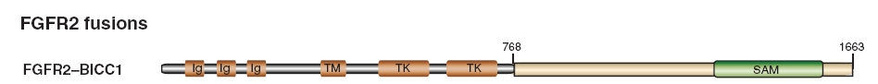
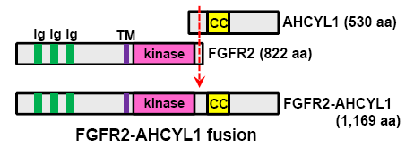
Identification of novel drivers by RNA-seq
FGFR2 rearrangements are frequent events in iCCA
FGFR2 Fusions
FGFR2-BICC1 Fusion (2 Cholangiocarcinoma)
Wu et al. Canc Discov 2013
FGFR2-AHCYL1 Fusion (13%)
Arai et al. Hepatology 2013
FGFR2–BICC1 mRNA
FGFR2 Fusion events
FGFR2-BICC1 + FGFR2-PPHLN1
38% (n=40)
45% (n=48)
Sia et al, Nat Commun 2015

Slide 18
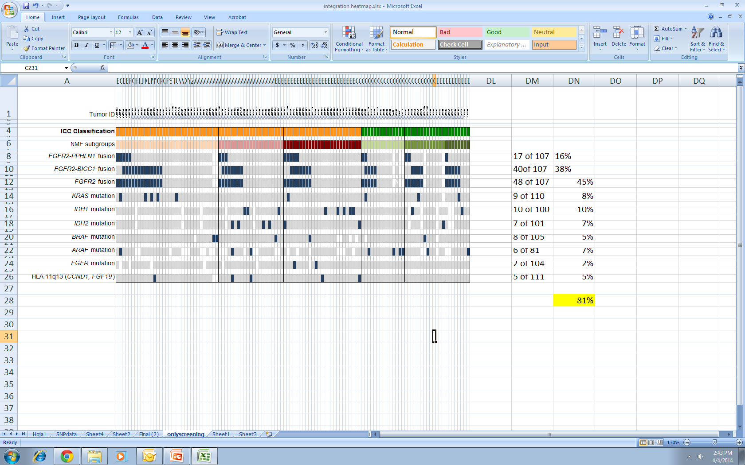
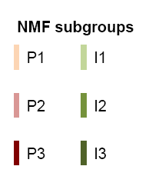
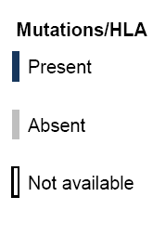
Landscape of genomic aberrations in iCCA
Integrative analysis with iCCA molecular classification
Proliferation
subclass
Inflammation
subclass
ICC Classification
NMF subgroups
FGFR2-PPHLN1 fusion
FGFR2-BICC1 fusion
FGFR2 fusion
KRAS mutation
IDH1 mutation
IDH2 mutation
BRAF mutation
ARAF mutation
EGFR mutation
HLA 11q13 (CCND1, FGF19)
n=114
16%
38%
45%
10%
10%
7%
4%
11%
2%
4%
69%
(79/114)
Sia et al, Nat Commun 2015

Slide 19
Conclusions
A novel tyrosine kinase fusion gene, FGFR2-PPHLN1, has been discovered in 16% of iCCA cases by next-generation sequencing. At the same time, similar FGFR2 fusions with different partners have been reported in iCCA.
Oncogenic potential of the FGFR2 fusions relies on the constitutive phosphorylation of the tyrosine kinase involved in the fusion event and activation of downstream pathway.
NIH3T3 embryonic fibroblast cells expressing FGFR2-PPHLN1 showed transforming capability, which was completely suppressed by the addition of the selective FGFR2 inhibitor BGJ398 .
iCCA cell lines engineered to over-express the fusion protein FGFR2-PPHLN1 show more aggressive phenotype in vitro that can be successfully inhibited by specific FGFR2 inhibitors.
Integrative analysis with our previously published iCCA molecular subclasses revealed that ~70% of patients harbor targetable molecular alterations (e.g. FGFR2 rearrangements, KRAS/BRAF/EGFR/IDH mutations) and more likely may respond to targeted molecular therapies.

Slide 20
Intrahepatic Cholangiocarcinoma
Novel targets for targeted therapies
Open issues:
Do the different FGFR2 fusions possess the same oncogenic potential in vitro and in vivo?
Can FGFR inhibitors inhibit the different FGFR2 fusions in animal models of iCCA?
Can we detect FGFR2 fusions in the plasma of iCCA patients (liquid biopsies)?
Can we design a low-cost device for the screening of the most prevalent druggable molecular aberrations identified so far in iCCA in order to guide tailored/personalized molecular treatment?
Moeini et al, CCR 2015

Slide 21
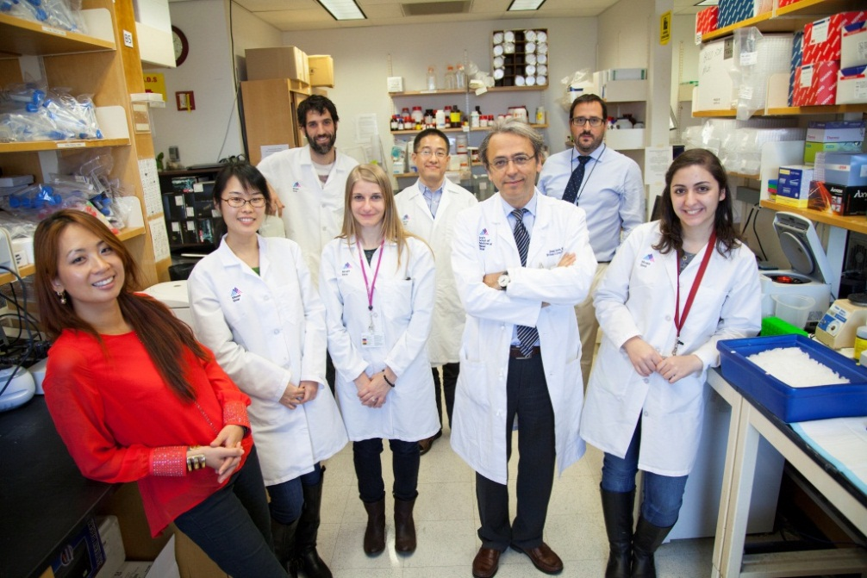


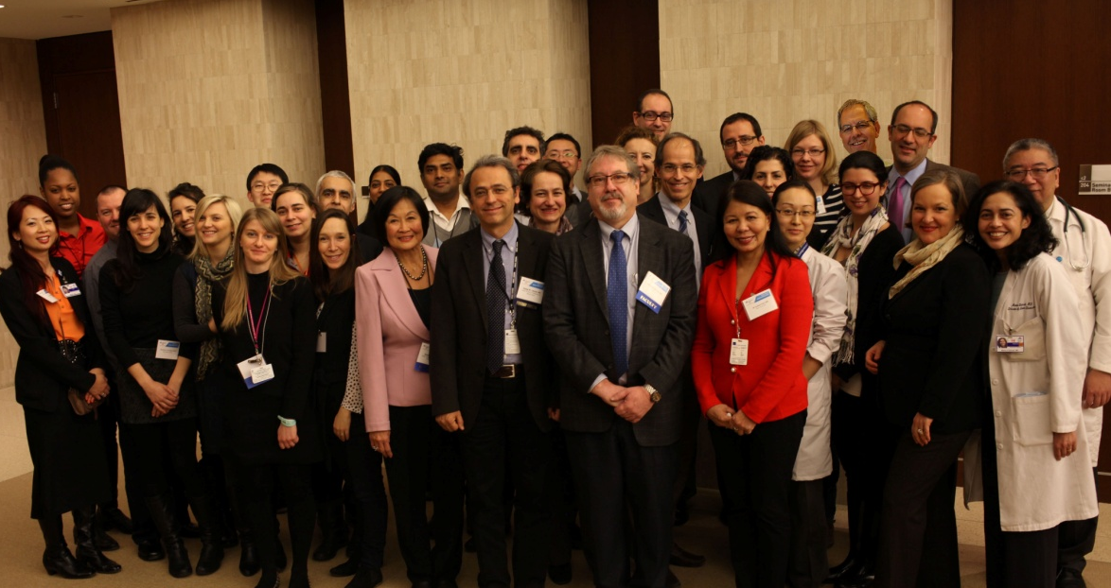



Acknowledgments

