Slide 1
Fibroblast growth factor receptor (FGFR) gene family aberrations in cholangiocarcinoma
Katsuyuki Miyabe, MD, PhD
Lewis R. Roberts, MB ChB, PhD

Slide 2
Introduction
I enrolled in Medical School and Graduate School in Japan
During my training I became aware of the enormous amount of innovative research and publications from Mayo Clinic
My cousin suffers from bile duct stone in her liver, which is a risk factor, so I wish to learn more about cholangiocarcinoma
I met with Dr. Lewis R. Roberts at a meeting in Kyoto, Japan, and was able to arrange to work with him as a visiting fellow
My portrait
Dr. Lewis R. Roberts

Slide 3
What is Cholangiocarcinoma (CCA)
CCA is a lethal bile duct cancer with only a few relatively ineffective treatments
Common cancer in Asia: the 6th most common cause of cancer in Japan
Subclassified into intrahepatic CCA, perihilar CCA, and distal CCA

Slide 4
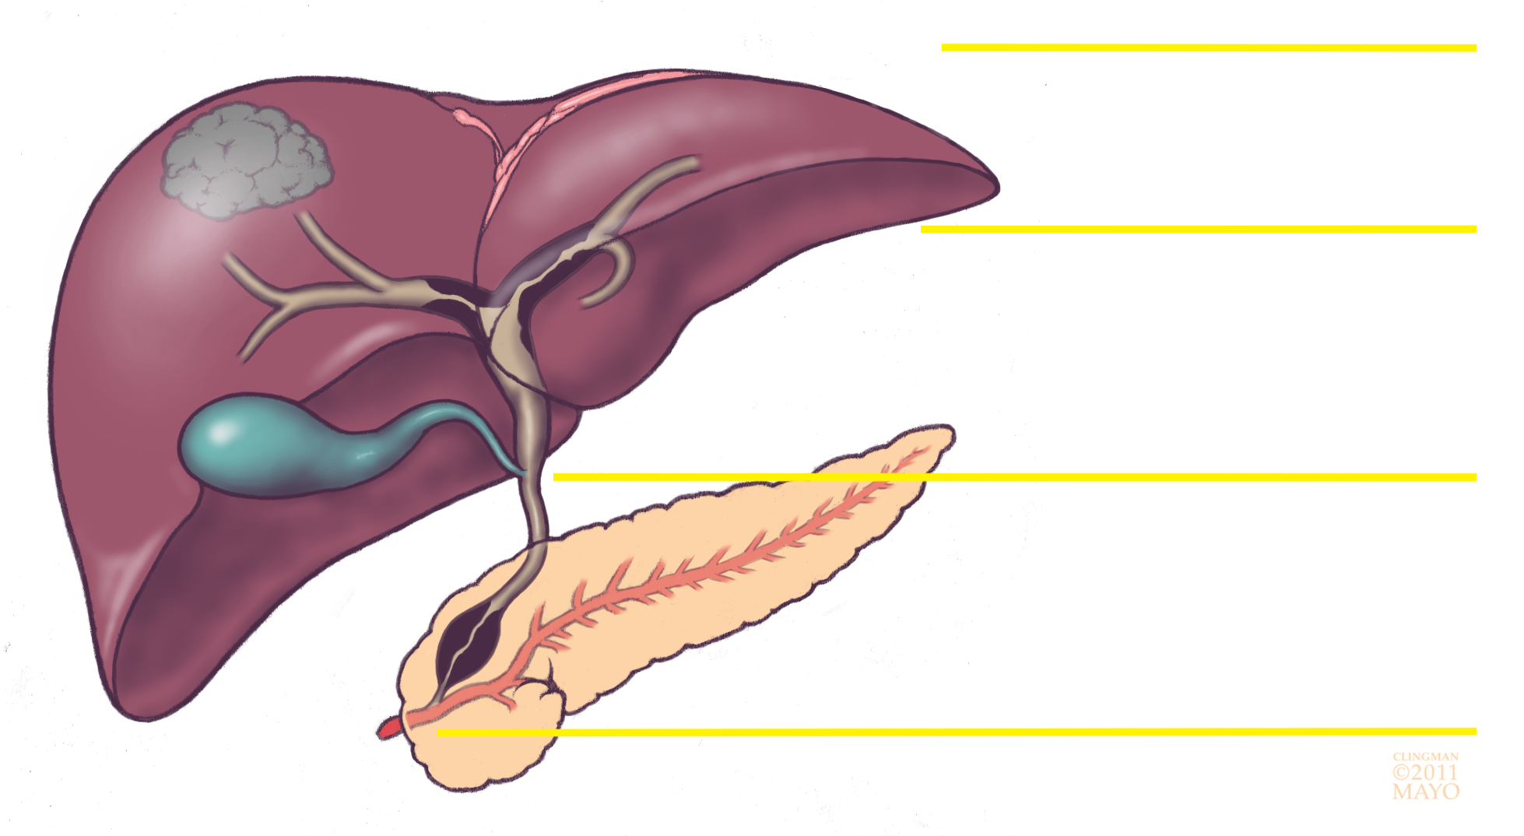
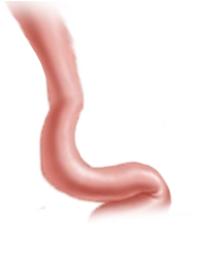
Classification of CCA
Intrahepatic CCA
Liver
Bile duct
Perihilar CCA
Gall bladder
Cystic duct
Distal CCA
Pancreas
Small intestine
Image Courtesy of Dr. Gregory Gores

Slide 5
There is a Need for More Research on CCA
Standard chemotherapy with gemcitabine and cisplatin improves median survival only from 8 to 12 months
New treatments are critically needed

Slide 6
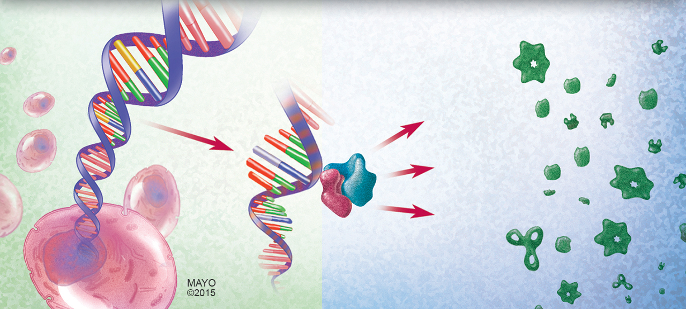
Gene and Chromosome Alterations Lead
to Development of Cancer
DNA
RNA
Protein
Database of instructions
Specific code of instructions
Functional products

Slide 7
Fibroblast Growth Factor Receptor (FGFR)
FGFR receptor
(FGFR 1, 2, 3, 4)
Cell membrane
FGF
P
GRB
SOS
Ras
PIK3 kinase
c-Raf
P
P
ACT1/mTOR
MAPK/Erk1/2
c-fos/c-jun
Cell growth
Angiogenesis
Cell survival
Cancer progression
(breast, bladder, esophageal, ovarian, and other cancers)

Slide 8
Gene and Chromosome Alterations Lead
to Development of Cancer
Amplification
Mutation

Slide 9
Chromosomal Translocation Results
in Gene Fusion
Fused gene

Slide 10
Fluorescence in situ hybridization (FISH)
Break apart FISH probes for detecting FGFR2 fusions
Normal cell
(signals together)
Cell with FGFR2 fusions
(signals broken apart)
Notes:
These figures show the procedure called fluorescence in situ hybridization, which detect the specific fusion. These are two different cells performed FISH using break-apart probe of FGFR2 fusion. The figure and picture on the left side show attached signal of red and green signals in a nucleus, which shows a chromosome without FGFR2 fusion. On the other hand, them on the right side show separated signal of red and green signals in a nucleus, which shows FGFR2 fusion.

Slide 11
FGFR2 Fusions may be Associated with Longer Survival of CCA Patients
156 CCA patients from Mayo Clinic were screened for FGFR2 fusions, which were identified in 8 percent of patients
Patients with FGFR2 fusions had a median survival of 123 months while patients without fusions survived 37 months
Gene alterations may affect the survival of patients with CCA
Graham RP, et al. PLoS Genetics 2014
Notes:
In addition, a study of 156 CCA patients from Mayo Clinic also identified those fusions in 8 percent of patient. Interestingly, patients whose tumors has FGFR2 fusions survived significantly longer than patients without FGFR2 fusions. Patients with the fusions survive 123 months while patients without the fusions survive 37 months. This suggests some other factors or gene alterations may affect the survival of patients with CCA.

Slide 12
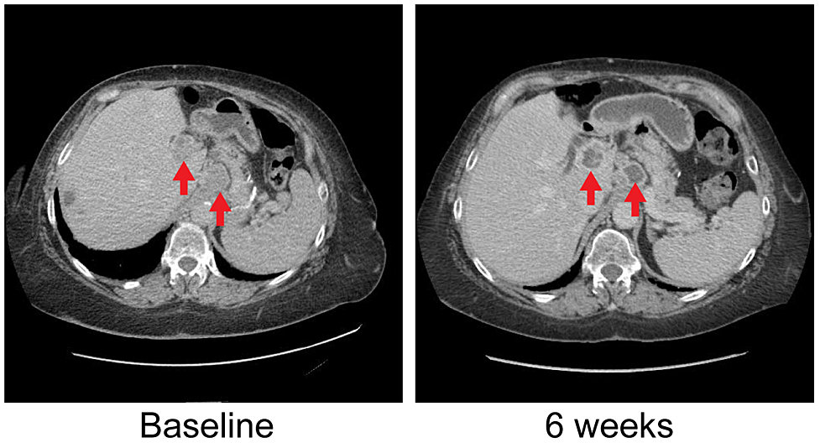
FGFR Inhibitor Induced Significant Shrinkage of Tumors Bearing FGFR2 Fusions
Malignant transformation
Patient 1:
Shrinkage of liver masses (red arrows)
Patient 2:
Shrinkage of lung metastases (green arrows)
Borad et al. PLoS Genetics 2014
Notes:
Indeed, a clinical trial at Mayo Clinic showed patients received targeted molecular therapy for those fusions. Look at the pictures of the slide. These patients have CCA with FGFR2 fusions and FGFR inhibitor was effective for them as we can see red arrows in patient 1 and yellow arrows in patient 2.

Slide 13
Mouse Model Experiment
Patient-derived CCA cells (PDX)
No Drug
Ponatinib
Dovitinib
BGJ398
Will FGFR inhibitors stop the growth of FGFR2 fusion bearing CCA cells implanted in mice?
Notes:
Additionally, we also recently evaluated the efficacy of a couple of drugs called FGFR inhibitors which are created to inhibit the cancer development by blocking the effect of FGFR fusion genes. As we can see in slides, we performed an experiment using mice. Each mouse was implanted patient-derived CCA cells (PDX) which have a FGFR fusion.

Slide 14
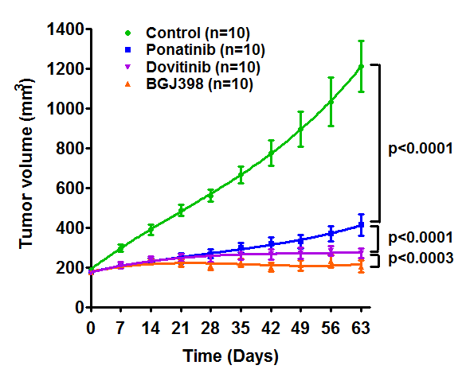
FGFR Inhibitors Significantly Inhibit Growth of CCA PDX Cells Bearing FGFR2 Fusion
All FGFR inhibitors inhibited growth of CCA cells implanted in mice
There are differences in effectiveness of different drugs
However, none of them completely eradicated the tumors

Slide 15
Summary of Background and Hypothesis
Fusions of FGFR genes have been discovered in CCA
Patients with the fusions may have longer survival
FGFR inhibitors blocked growth of CCA cells
However, none of them completely eradicated tumors
Hypothesis: Patients with FGFR gene alterations other than fusions will have a worse prognosis and these alterations are important therapeutic targets in CCA
FGFR1 Amplification?
FGFR3 Mutation?
FGFR2 fusion
FGFR4 fusion?
Other alterations other than FGFR2 fusions?

Slide 16
Aim 1
Objective:
To identify novel FGFR family gene aberrations in CCA
Approach:
RNA from 100 patient tissues will be analyzed by RNA sequencing to discover specific FGFR gene alterations

Slide 17
Aim 2
Objective:
To evaluate the effect of FGFR protein alterations on signaling pathways during development of CCA
Approach:
To measure levels of altered FGFR proteins in CCA
To evaluate the effect of FGFR on downstream signaling proteins
An example of detecting proteins
Phospho-FGFR2
FGFR2
Actin

Slide 18
Aim 3:
Objective: To evaluate the effectiveness of specific FGFR inhibitors in cell lines and mouse models bearing FGFR alterations
Approach: Cell lines:
1. To develop CCA cell lines bearing the novel FGFR alterations we discover
2. To examine the growth of tumors bearing novel FGFR alterations in the presence or absence of FGFR inhibitors
Mouse models:
3. To evaluate the growth of CCA cells with specific gene alterations implanted subcutaneously in nude mice
4. To test the effect of different FGFR inhibitors on implanted CCA PDXs and determine the effectiveness of targeting FGFR alterations in treatment of CCA

Slide 19
Summary and Conclusion
Challenges in treatment of CCA patients identify this field as "a contemporary frontier of medicine”
We expect to identify additional novel FGFR target alterations and to determine their relative sensitivities to different FGFR inhibitors
The results of our studies will allow us to personalize the therapeutic options for patients with CCA by selecting the specific FGFR inhibitor that is most likely to achieve a clinical effect, and therefore enhance patient outcomes

Slide 20
Thanks to Cholangiocarcinoma Foundation

