Slide 1
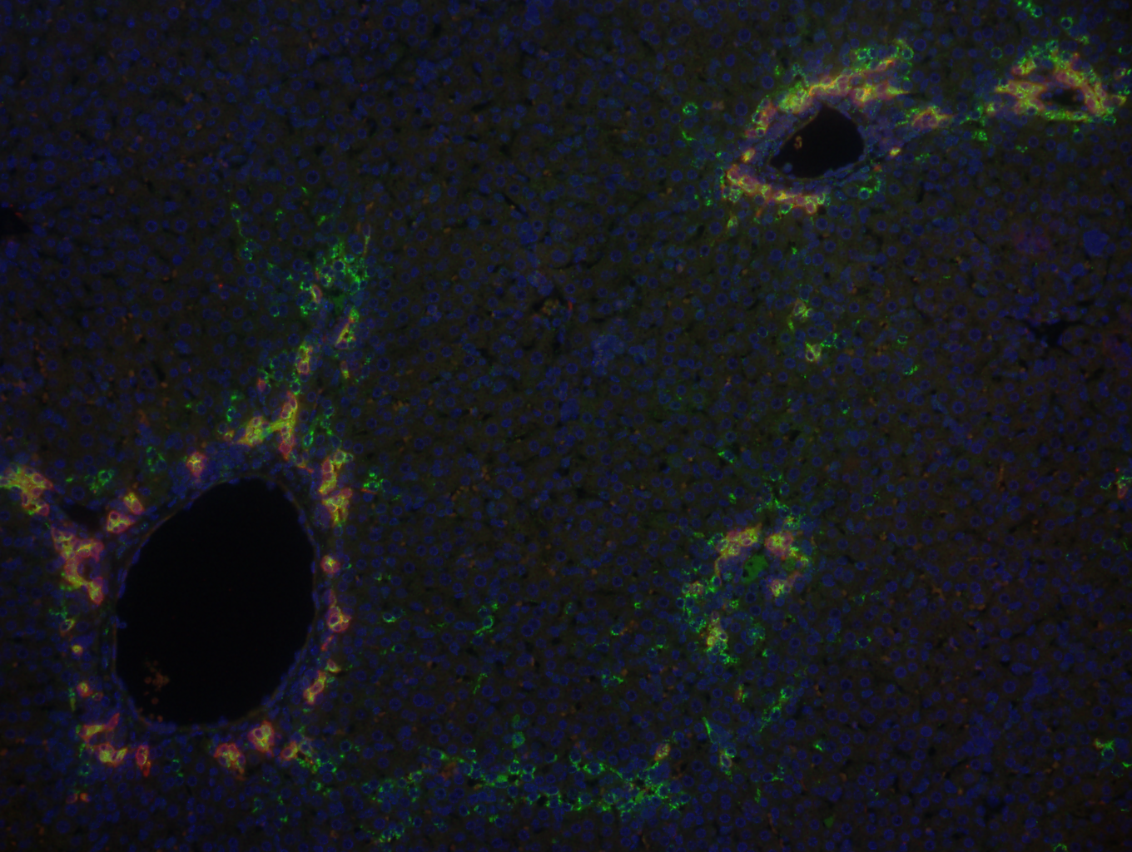
Determining the Cellular Origins of Cholangiocarcinoma
Allyson Merrell
Stanger Lab
November 9, 2015

Slide 2
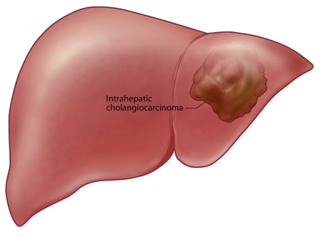
The process of cholangiocarcinoma development is not fully understood
National Cancer Institute estimates there will be 35,660 new cases of liver cancer in 2015
Most of what is known about cholangiocarcinoma formation is based on the physical appearance of the tumors, not on molecular data
Notes:
Goals: To provide clarity regarding the cell of origin of cholangiocarcinoma
To determine if cellular reprogramming plays a role in the development of cholangiocarcinoma

Slide 3
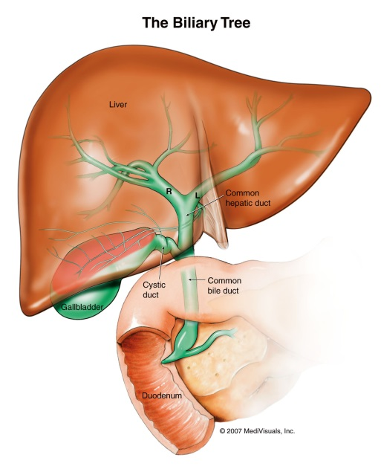
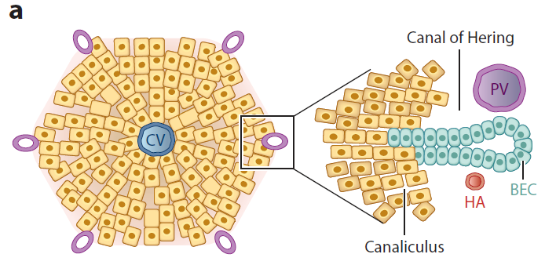
The liver is composed of hepatocytes and biliary cells
Bile Duct
(Biliary Cells)
Hepatocytes
Notes:
Main function to detoxification, produce bile for digestion
Hepatocytes produce bile salts while the biliary cells help transport bile to the intestine

Slide 4
Hepatocytes and biliary cells originate from hepatoblasts during development
Hepatoblasts next to portal vein receive signals to become biliary cells
Other hepatoblasts become hepatocytes
Hepatoblasts
Hepatocytes
Portal Vein
Biliary Cells
Adapted from Zong 2013

Slide 5
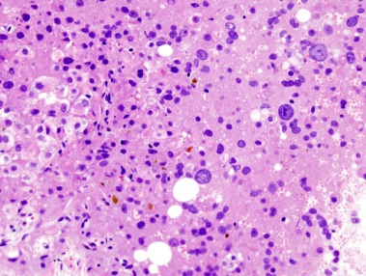
Previous theories proposed that each liver cell type gave rise to particular liver cancers
Based on appearance:
Hepatocellular carcinoma (HCC)
Looks like hepatocytes
Intrahepatic cholangiocarcinoma (ICC)
Looks like bile ducts
HCC
ICC

Slide 6
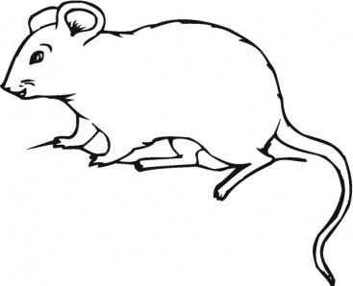
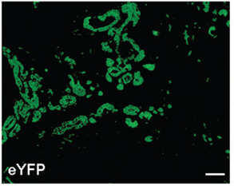
Biliary cells can give rise to cholangiocarcinoma
Guest, et al, 2013
TAA toxin + p53 deletion
ICC
+YFP cell label
Given the right genetic conditions, biliary cells can form cholangiocarcinomas

Slide 7
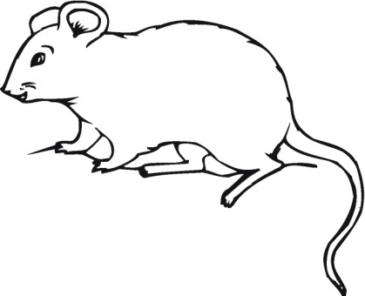
Surprisingly, hepatocytes can also give rise to cholangiocarcinoma
Sekiya, et al, 2012
ICC
Blue-labeled hepatocytes in tumor
TAA toxin
+ Genetic label
No labeled biliary cells in tumor
No ICC
+ Genetic label
Fan, et al, 2012
Notch + AKT activation
ICC
YFP labeled hepatocytes

Slide 8
Aim 1: Are there conditions in which only particular cell types induce cholangiocarcinoma?
In which cell types do particular mutations induce cholangiocarcinoma?
?
Cholangiocarcinoma
?
?

Slide 9
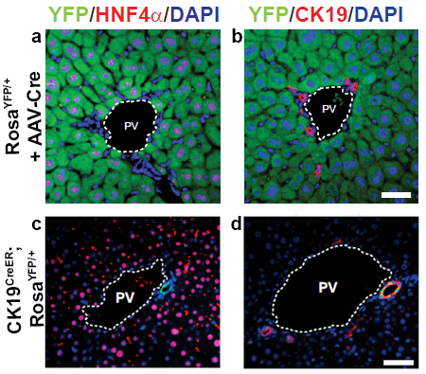
We will specifically label and mutate either hepatocytes or biliary cells
Using genetic tools, we can fluorescently label and genetically mutate mice specifically in hepatocytes or biliary cells
Green hepatocytes, but not biliary cells
Labeled bile ducts, but not hepatocytes
PV=Portal Vein

Slide 10
Experimental approach to determine the cellular origin of cholangiocarcinoma
Activate AKT and Notch:
Activated Kras and p53 deletion:
ICC
?
?
?
Developmental activation/deletion in hepatoblasts induces ICC
Carcinogenic toxin (DDC) and p53 deletion
?
Previous work with another toxin (TAA) found that only hepatocytes could form ICC. However, another study found that with TAA and p53 deletion, the biliary cells form ICC. Can both cells form ICC with p53 deletion? Does one form ICC more readily?
?

Slide 11
Hepatocytes can change type when stressed by injury or signals
Recent studies have found that hepatocytes can become biliary cells with injury or signaling changes
Hepatocytes turn off genes specific to hepatocytes and turn on biliary genes
Hepatocytes
Partially reprogrammed cells
Hepatocyte-derived biliary cells
Yanger 2014

Slide 12
Do cholangiocarcinoma-forming hepatocytes first reprogram into biliary cells?
Cholangiocarcinomas formed from hepatocytes take on the appearance of biliary cells
Many stresses that induce reprogramming also induce cholangiocarcinoma
Hepatocytes
Partially reprogrammed cells
Hepatocyte-derived biliary cells
Yanger 2014

Slide 13
Aim 2: Is reprogramming a characteristic of hepatocytes forming cholangiocarcinoma?
Hepatocytes
Hepatocellular Carcinoma
AKT activation
Reprogrammed cell
?
Reprogramming
Cholangiocarcinoma
AKT and Notch activation
Is there evidence of reprogramming when hepatocytes form cholangiocarcinoma?

Slide 14
A better understanding of cholangiocarcinoma can help improve therapies
Understanding which cell type gives rise to cancer with particular mutations may allow us to target therapies to cancers with different origins
If reprogramming is a critical feature of cholangiocarcinoma development, we can target therapies to interrupt this process under pathological conditions

Slide 15
Acknowledgments
Stanger Lab:
Ben Stanger
Ravi Maddipati
Yi-Ju Chen
Nicole Aiello
Neha Bhagwat
David Balli
Taiji Yamazoe
Chenghua Yang
Robert Norgard
Jinyang Li
Funded by:
The Cholangiocarcinoma Foundation

