Slide 1
SOCIAL MEDIA
Allison Deragon

Slide 3
Main objectives
•Help you understand the importance of social media through a CCF perspective
•Help you know how to use social media to amplify CCF’s messaging

Slide 4
Social media channels

Slide 5
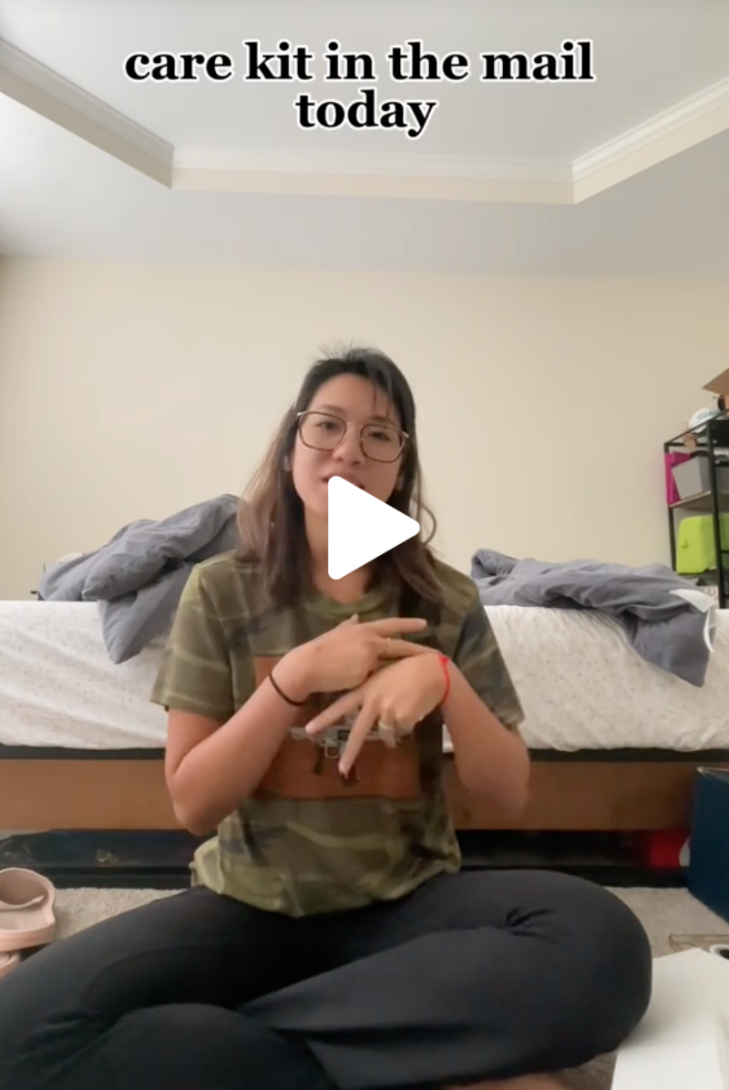
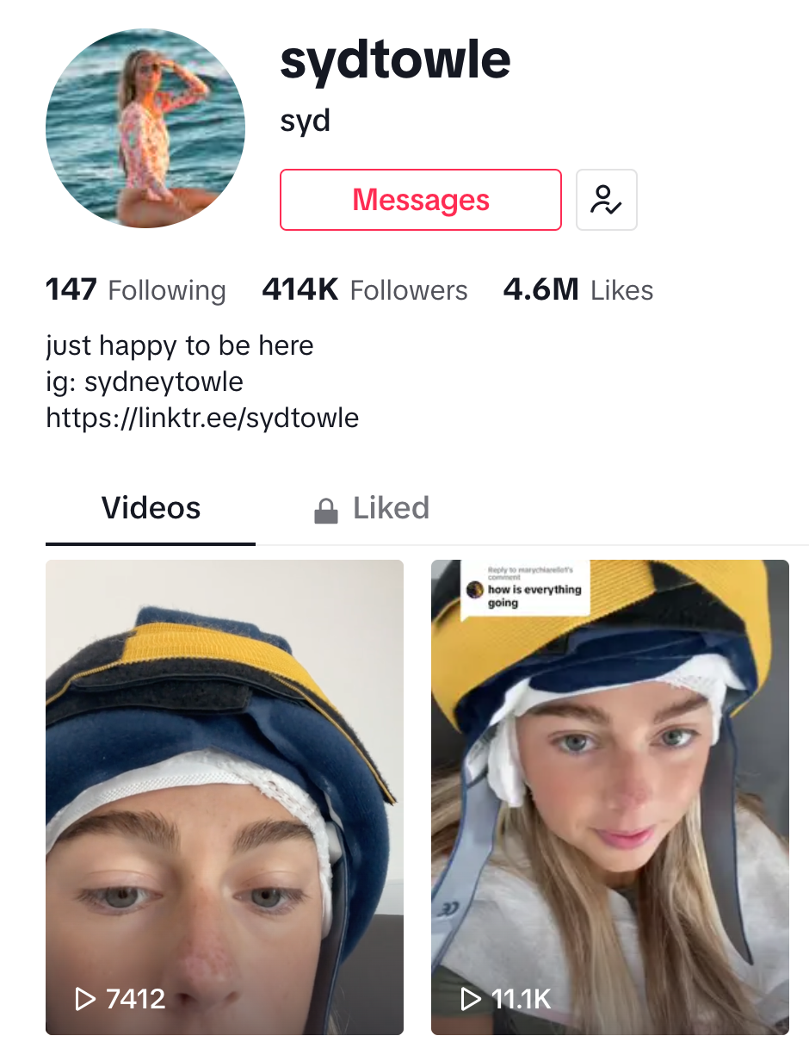
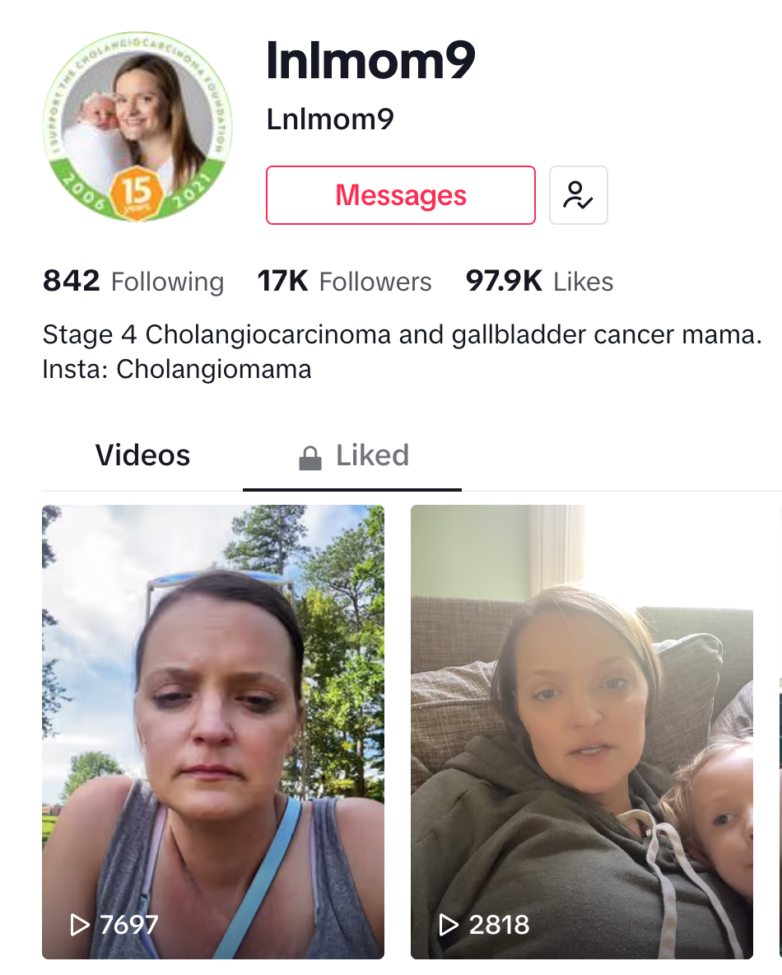
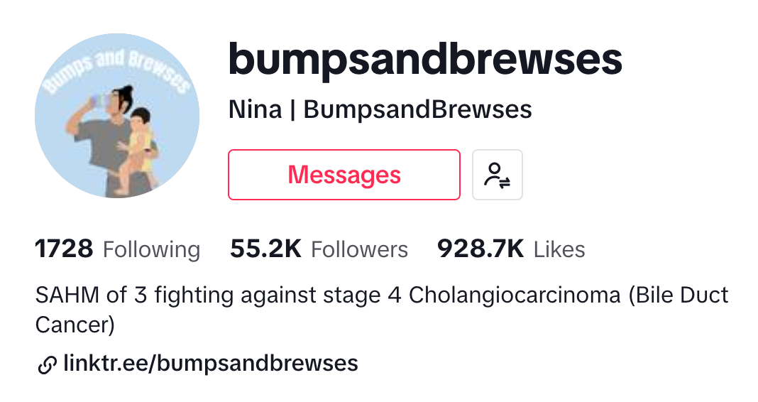
tiktok

Slide 6
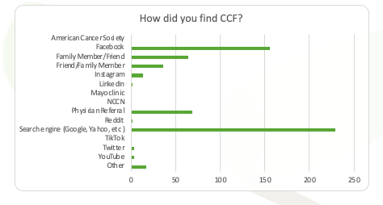
Impact of social media

Slide 7
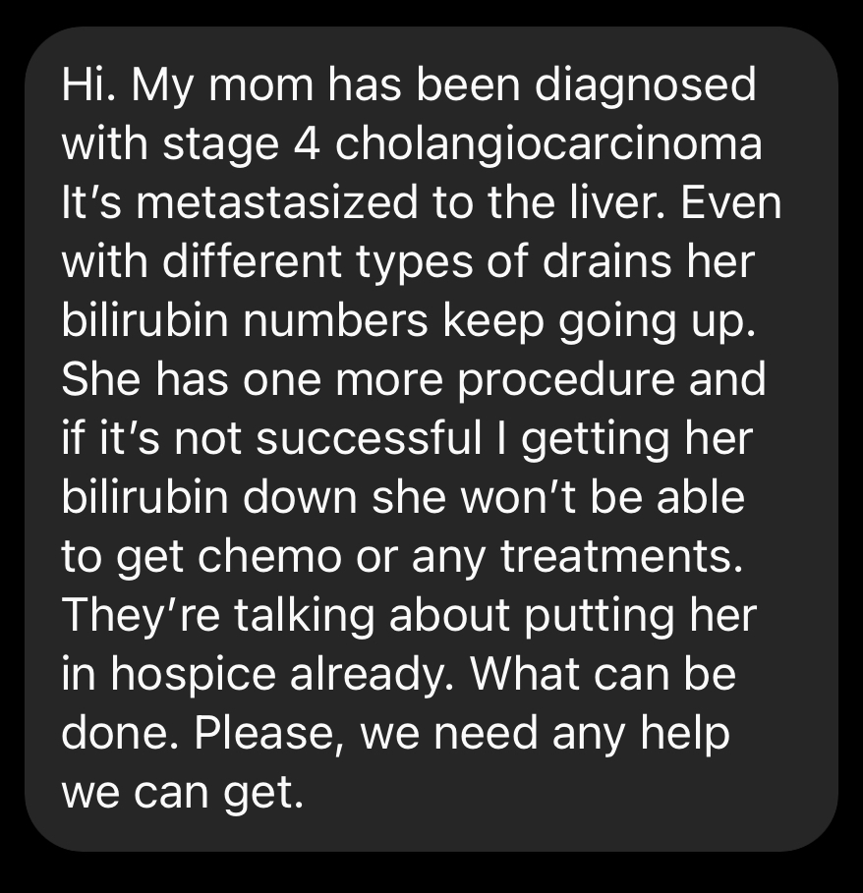
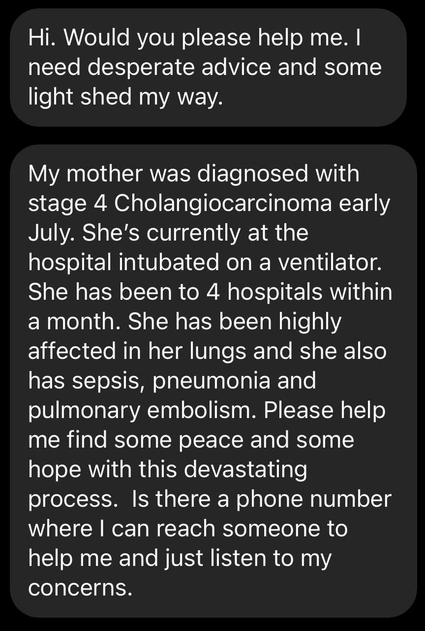
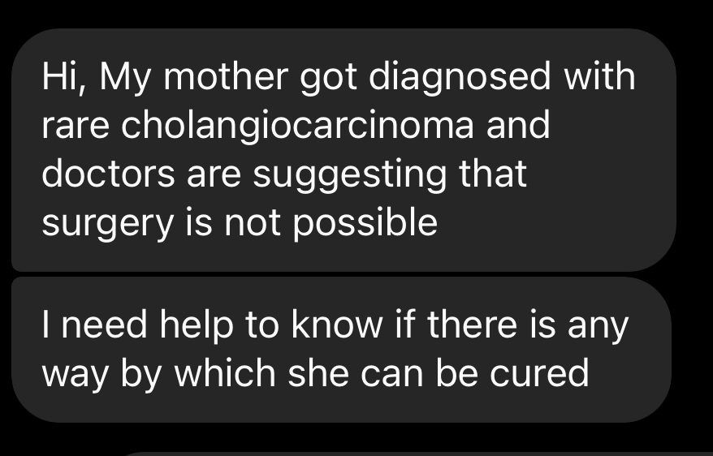

Slide 8
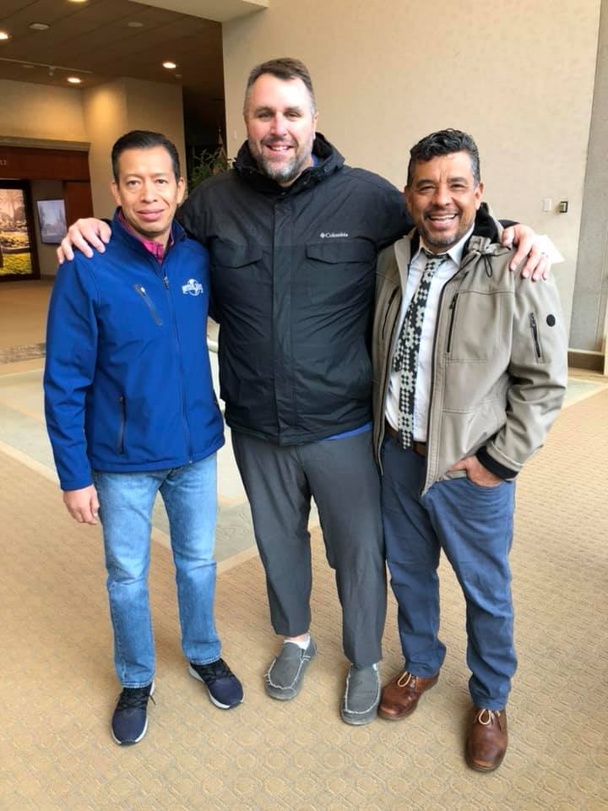
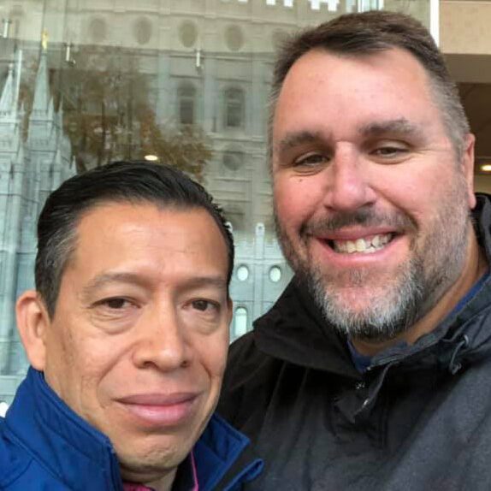
Dad, Carlos and eldon
“I know that we were supposed to meet today.”

Slide 9
Engagement
Liking and commenting on our posts show that our content is relevant meaning that social media platforms will push it out more

Slide 10
Sharing our posts
• Add your own words
• Keep your message clear
• Include a CTA
• Tag CCF and use a hashtag

Slide 11
CCF Hashtags you can use
#cureCCA
#CCAhope
#cholangiocarcinoma
#bileductcancer
#CCF

Slide 12
How to Tag CCF
@

Slide 13
Best practices for posting
K- keep
I- it
S- short
S- simple

Slide 14
•Quality Picture
•Clear Messaging
•Use hashtags
•Tag CCF
•Include a CTA

Slide 15
